Slide 1
Training and Assessment within UBS Biofacilities

Slide 2

Overview
Terminology
Legal requirements
Who can train?
Who can assess?
Process overview
New and experienced individuals
Maintaining competency
Adding training records
Q&A

Slide 3
Terminology
UBS: University Biomedical Services
MCMS: Mouse Colony Management System (database)
DOPS: Direct Observation of Practical Skills
PEL: Procedural Establishment Licence
PPL: Procedural Project Licence
PIL: Procedural Individual Licence

Slide 4

Legal Requirements
PEL: ‘Staff shall be adequately educated and trained before they perform any function relating to the care of the protected animals and shall be supervised when performing any such function until they have demonstrated the requisite competence’
PPL: ‘Appropriate level of supervision is provided for all personal licensees carrying out regulated procedures under the authority of this licence’
PIL: ‘maintain a record of all procedures carried out including details of supervision and competence’

Slide 5
Legal Requirements
Every person working with animals should be able to demonstrate their training and competency records
The Home Office often focus on training and competency, so it’s important that records show:
            The current ability level > competency/supervision level
            How the ability level was reached > training records
            How that level was assessed > assessment documents e.g. DOPS
            When the ability level will be re-assessed > review dates

Slide 6
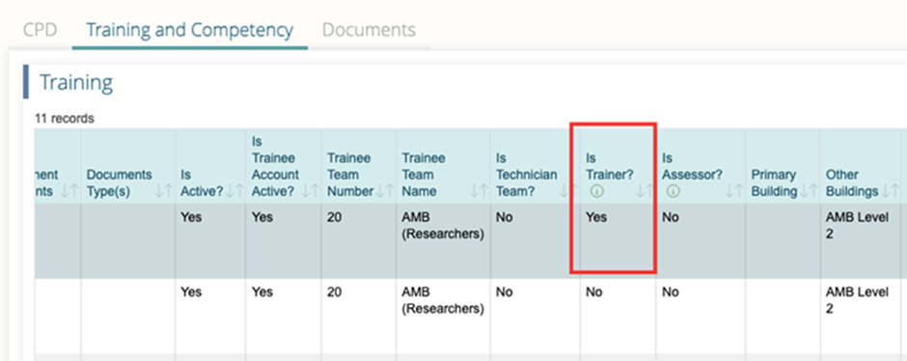
Trainers
Must be competent in the technique and a suitable person to train
Train the Trainer course is compulsory for UBS staff and is encouraged for researchers
Must be a trainer for the task on MCMS to add training records and notes for each session

Slide 7
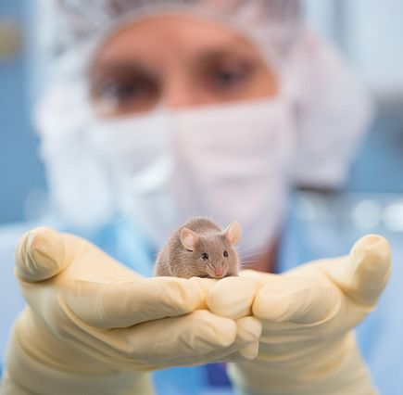
Assessors
Must have completed either the Researcher Assessor Course or the Nominated Assessor Course
They do not need to have an up-to-date competency in the technique they are assessing but must have a sound grasp of how it is performed
For Schedule 1 killing techniques, UBS staff must carry out training and assessments
Dates for the courses can be found on the UBS Training Centre website

Slide 8

Finding Trainers and Assessors
Researchers should speak to their group leaders for trainers and assessors within their group
Contact the unit NACWO for details of UBS trainer and assessors
All NACWOs and assessors have access to a list of assessors on Moodle
Contact the UBS Training Centre if struggling to find relevant people

Slide 9
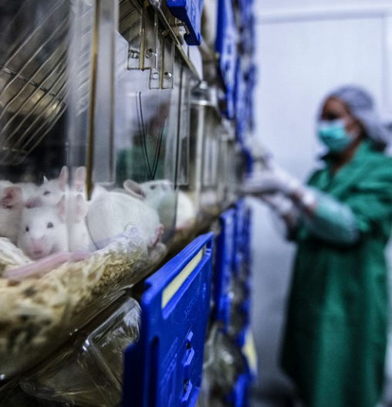
Overview of General Process
Arrange training
Attend training sessions until deemed ready for assessment by trainer (recorded on MCMS)
Arrange a DOPS assessment with an assessor
Pass DOPS assessment
Assessor uploads DOPS form to MCMS and adds competency
Endorse your training record on MCMS
Competent to carry out task
Maintain competency
Attend reviews and reassessments as required

Slide 10
Process for New Starters
MCMS account set up
Organise training with UBS trainers
Organise training with competent trainers within research group
Usually upon completion of PIL course
MCMS training is available from the Database Manager
Handling, restraint and sexing (and any other local requirements)
Automated Watering System (if using)
Schedule 1 killing techniques
Procedural techniques
Husbandry tasks e.g. weighing
Organise DOPS assessments with assessors
Handling, AWS and Schedule 1 with UBS assessors
Other husbandry and procedural techniques by any assessor
Endorse records on MCMS
Once assessments and DOPS forms are added by the assessor
Carry out reviews or reassessments when required
MCMS will send out automated alerts when a reviews are due

Slide 11
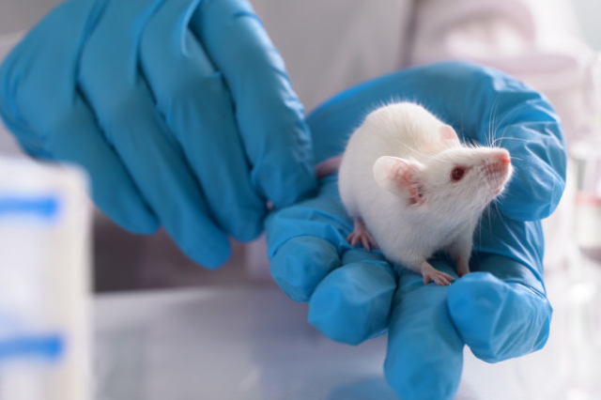
Process for New Starters
UBS trainers can help in training common regulated procedures and husbandry techniques
Please request help as early as possible to avoid delays
Note: To be added to the University Euthanasia Register for a Schedule 1 method the assessment must be in date and endorsed.
It is a Home Office requirement that individuals who perform Schedule 1 techniques are entered on the register with both the specific techniques and species.

Slide 12
Process for Experienced Staff
Check that all tasks have a training record on MCMS
Check that tasks have DOPS assessments
Organise DOPS assessments
Ask trainers to add records
Contact the Database Manager and T&C Supervisor
Assessors can add DOPS forms
Tasks that have no assessment
Competencies that are overdue or due to expire
Endorse records on MCMS
Once assessments and DOPS forms are added by the assessor
Remove unused records
Contact the Database Manager and T&C Supervisor
Paper records can be uploaded
Deactivate those not currently in use
Delete those no longer relevant/used

Slide 13
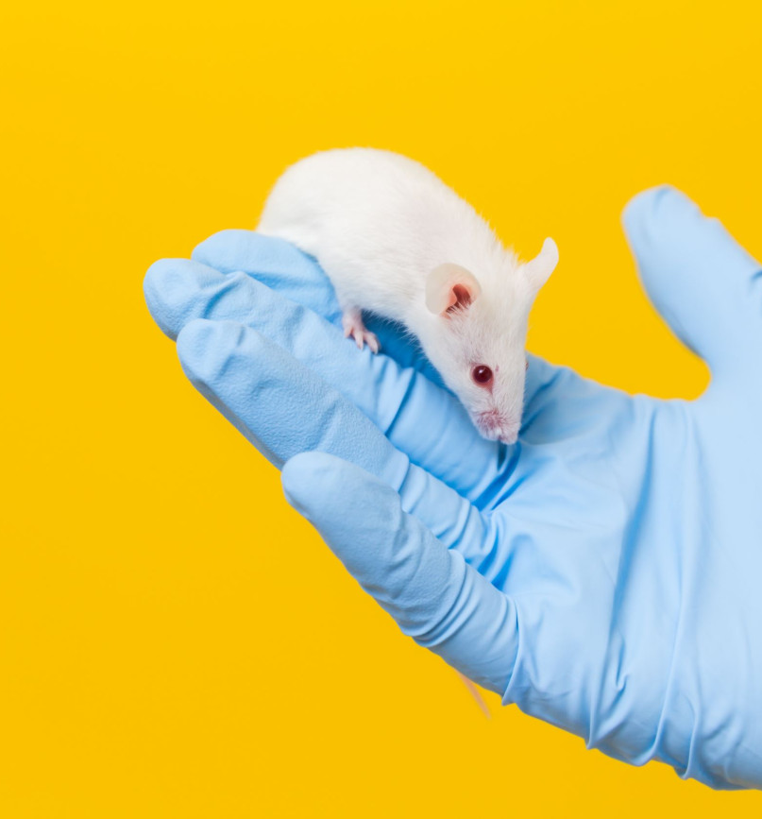
Maintaining Competency
It is the individual’s responsibility to keep skills up-to-date
This can be achieved by:
  Regularly carrying out the task and following the SOP
  Having refresher training when required
  Having regular re-assessments
  Keeping up to date with the latest techniques and processes

Slide 14

Competency Reviews
Competency is reviewed regularly, usually every 3 years
MCMS will remind you when this is due
3 options available at this point:
    Re-assessments / review to be arranged as soon as possible
    De-activation of records (reversible)
    Deletion of records (cannot be reversed)
IMPORTANT: Schedule 1 killing records will not show on the Euthanasia register unless the assessments are in date and endorsed

Slide 15

Competency Reviews / Reassessments
When you are due for reassessment you have the following possibilities:
Competency Review – No new DOPS assessment required
Competency Reassessment – New DOPS assessment required

Slide 16
Competency Reviews and Reassessments
Competency Review
ALL of the following apply:
Currently competent
Regularly carrying out the task
Has already been DOPS assessed
Competency Reassessment
ANY of the following apply:
Not currently competent
Hasn’t done the technique recently
Hasn’t been DOPS assessed

Slide 17
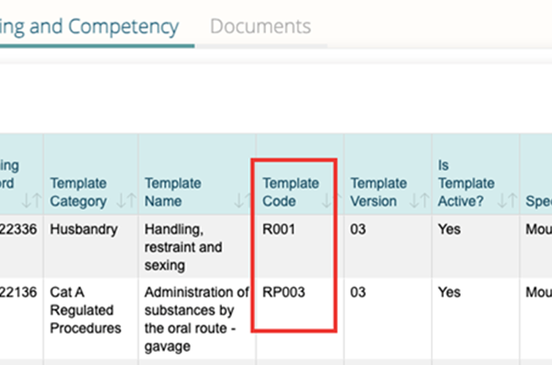
FAQs - Adding Training Records and Notes
If a trainer cannot add a training record, check the following:
  Have they been assessed and signed off as a Trainer on MCMS?
  Is the ‘Is Trainer?’ box ticked?
  Has the correct template code been chosen for the species?
  If unsure of the issue, contact the Database Manager or the Training Centre

Slide 18
Useful contacts:
UBS Training Centre: ubstraining@admin.cam.ac.uk
Pilar, Lisa, and Claudia at the Training Centre will normally be your first port of call for any training and assessment queries. We can help with explaining processes, arranging training and assessment, writing, finding and reviewing DOPS, updating MCMS records, and any other problems you may have.
Training Centre Resources: https://www.ubs.admin.cam.ac.uk/training-centre/resources
A self-help resource which contains information on UBS’ training and assessment processes with FAQs.
Database Manager: maryann.haskings@admin.cam.ac.uk
Mary Ann adds users onto the MCMS system and can help with MCMS training, adding or deleting records, and help with any problems. See also the UBS MCMS Database Guides on Moodle: https://www.vle.cam.ac.uk/course/view.php?id=140221
Named Training and Competency Officers: ubsntco@admin.cam.ac.uk
The NTCOs bear the legal responsibility for training and assessment within the University. They may be contacted about any problems with processes or within the facilities. Please contact the Training Centre for practical training and assessment issues.
UBS Licencing Team: ubsholicencing@admin.cam.ac.uk
The licencing team can advise on licence applications and processes. They also carry out the PIL review process.

