Slide 1

Strain Terminology
Ahead of Genetic Background Presentation
Colony Management Group June 2023
Dr Amelia Phillips MRCVS
Veterinary Surgeon
University Biomedical Services

Slide 2
Purpose
To provide a bit of background knowledge to strain terminology in order to support our guest speaker presentation
To provide a bit of history and back-story to the Black 6!
Based on a presentation by Fernando Benavides, DVM, PhD, ACLAM, February 15, 2023, KM-LAS-EDU CPD Webinar

Slide 3
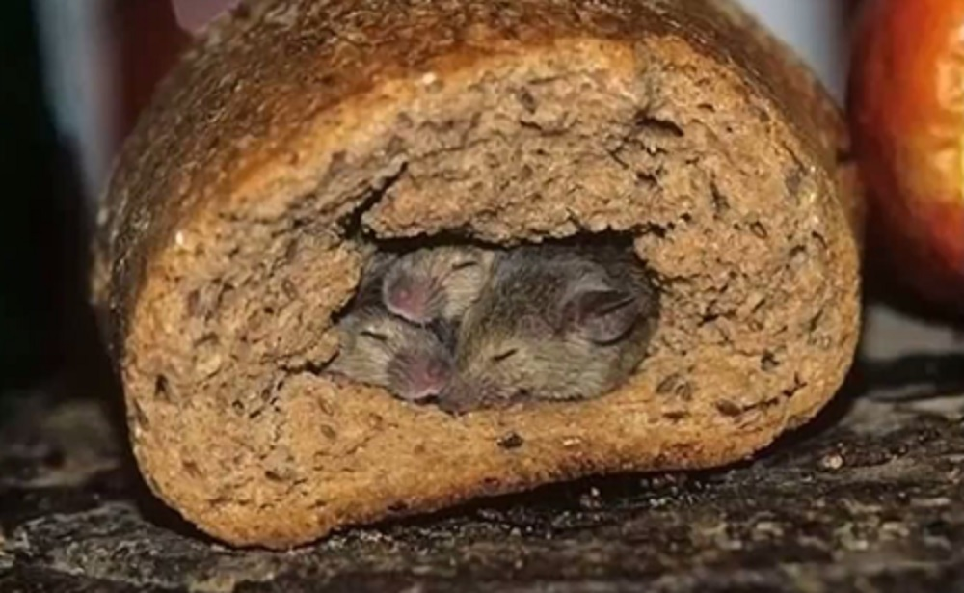
Inbred strains only
Substrains come from:
  Residual heterozygosity (so not as inbred as you thought!)
  Genetic drift
  Separation of a sub colony

Slide 4
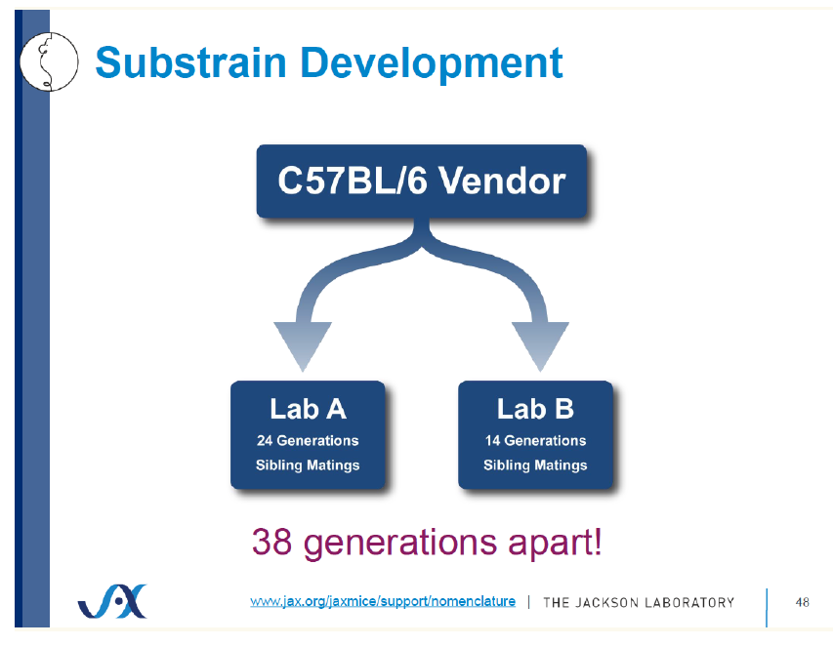
Separation of a sub colony

Slide 5
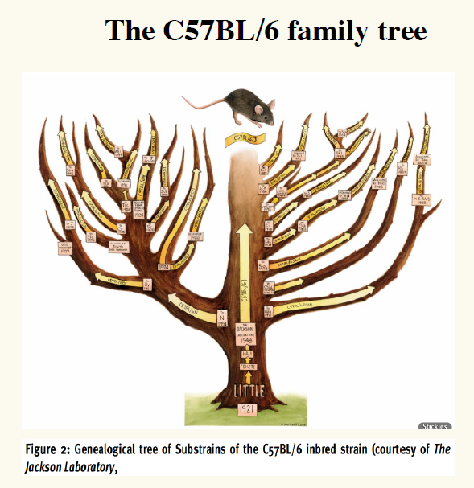

Slide 6
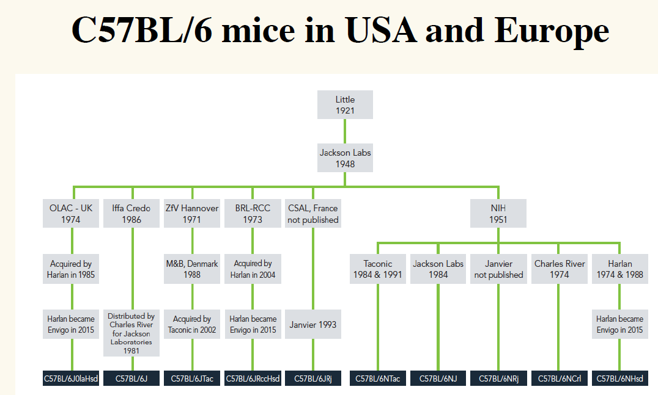
BL/6
J
N

Slide 7
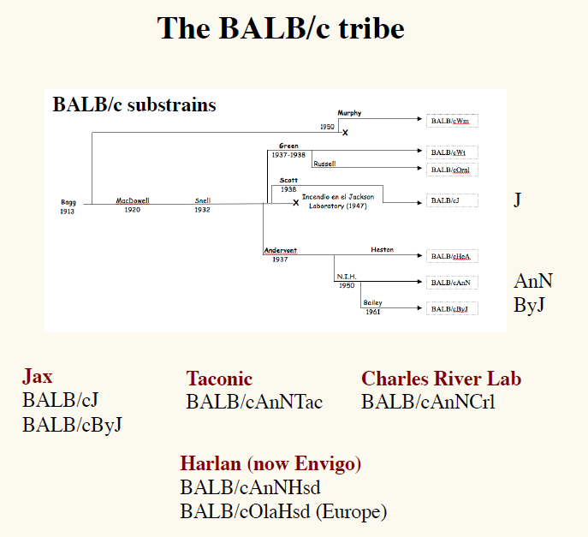

Slide 8
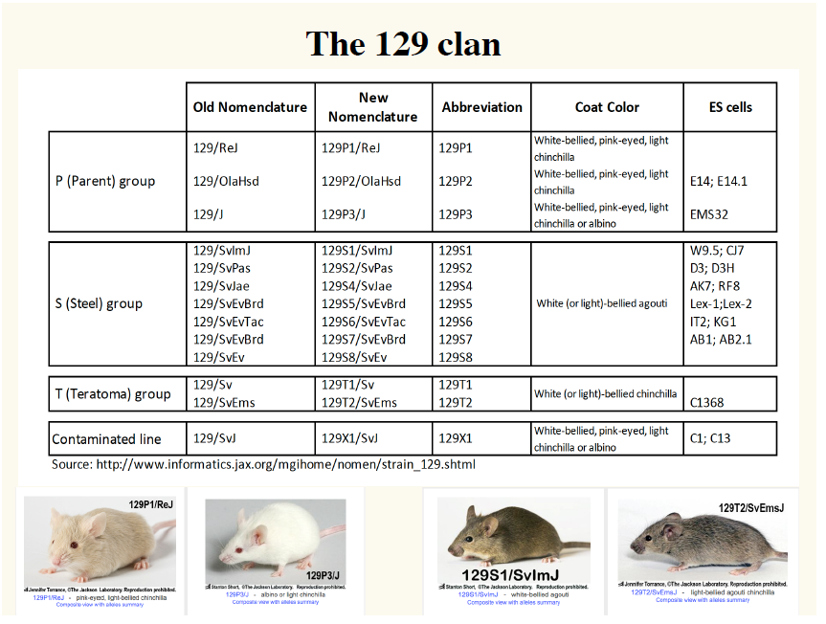

Slide 9

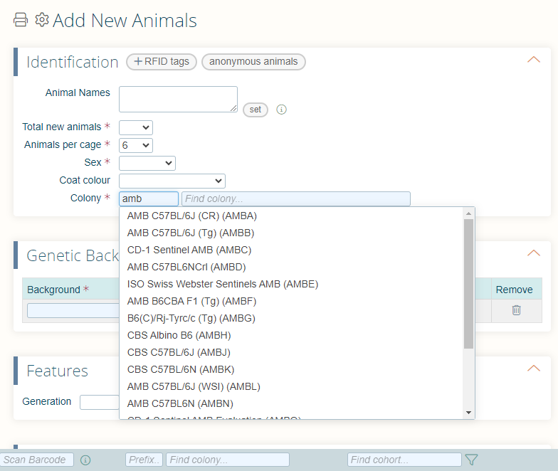
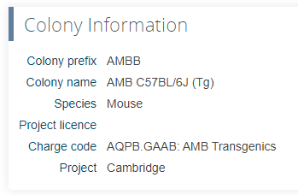
MCMS

