Slide 1
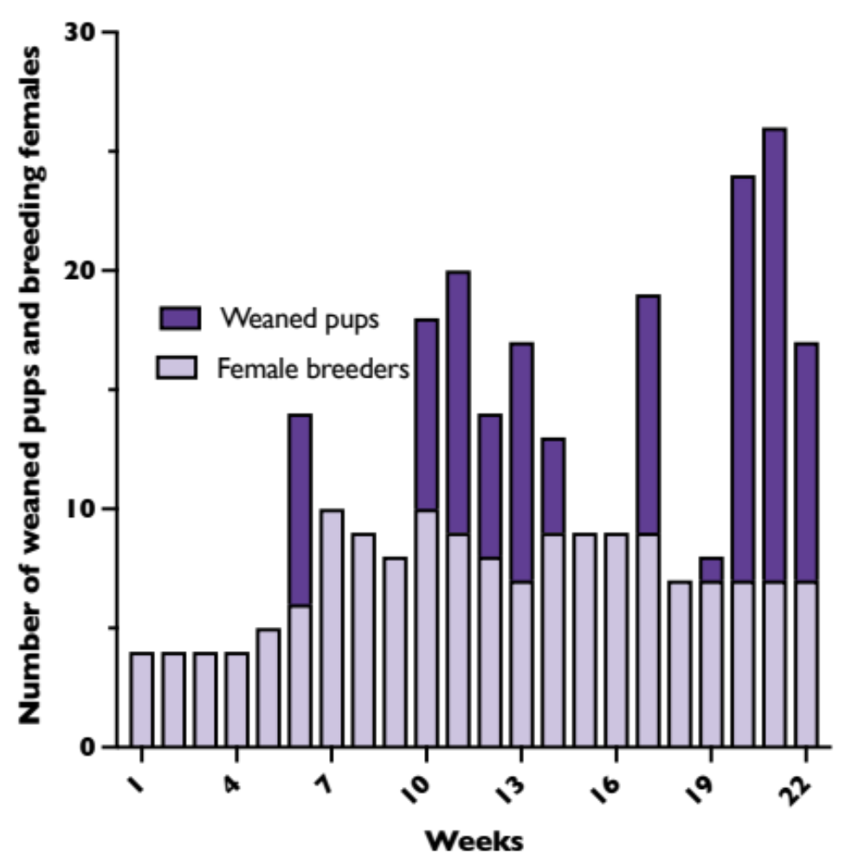
Glanzmann Thrombasthenia Colony: Refinements and Reduction
M. Penn, A. Warner, V. Pell, J. Reckless.
RxCelerate Ltd. Dorothy Hodgkin Building B950, Babraham Research Campus, Cambridge, CB22 3FH
1
Background
4
Results
The ß3 integrin null (KO) mouse model show all the cardinal features of the human bleeding disorder Glanzmann Thrombasthenia (GT), causing prolonged bleeding times, and spontaneous cutaneous and gastrointestinal (GI) bleeding events.
Although the strain appeared in the literature, there was little information on the care and welfare of these mice. The supplier noted that all spontaneous bleed events resulted in the mice being culled, necessitate larger-scale breeding to produce sufficient numbers of mice for study.
With an established colony needed for research, and the uncertainty of Covid-19, making the most of the available time in the units to refine colony management and reduce overall numbers was of increased importance. Microsoft Teams was to be used to help our team document the colony and enable rapid remote decision making on any action to be taken, and changes to be made.
1. Breeding
Following the first 7 weeks of colony breeding, breeding pairs began to be replaced with trios, by adding a new female to the breeding pair. By week 10 more litters were born and the success of survival for those litters increased (Figure opposite).
A reduction in scratching events was noticeable when moving from pairs to trios.
Separate nesting areas in enclosed houses were provided in each breeding cage. The occasional litter did make use of the option to feed them separately.
A
2. Environment and husbandry
Alpha-dri substrate easily indicated that blood was present in the cage. This helped with monitoring and determining the duration of chronic bleeds (Image C).
A reduction in dust aided in the treatment of scratch wounds, by reducing irritation.
Chronic water restriction issues and clinical signs such as tremoring had stopped following extra access to water (Image A and B)
An increase in water uptake, along with preventing wood and splinter ingestion, would likely have a positive impact on chronic GI tract bleeds, although this could not be quantified.
2
Objective
To refine the GT colony housing and husbandry and reduce the quantity of mice bred for experimental output by:
Increasing breeding performance.
Making general environmental improvements to increase the welfare of mice with the GT phenotype.
Reducing the number of mice culled due to superficial bleeding.
B
C
3. Superficial bleeding
75% of mice treated with styptic powder recovered and if a repeated event was seen the mouse was culled.
During necropsy all mice with repeated scratching had a phenotypic enlarged spleen due to GI tract bleeding.
Following a bleeding event (Image A), recovery (Image D) was now an option and mice could continue breeding or reach the age required for study. This has helped reduce the quantity of breeders and stock.
D
3
Refinement Methods
Breeding – Glanzmann mice are reported to have an average litter size of 4.6 ± 2.9 due to placental and fetal bleeding, and dystocia was evident in our colony. A smaller litter would experience less heat from the newborn huddle and reduced maternal care, overall decreasing survival rates.
  We introduced breeding trios to increase the number of pups within the cage to 8.6 ± 2.8, normal for their background strain, C57BL/6. Parental stimulation was therefore at a more natural level and fostering could be provided if required.
  Trios are reportedly associated with increased pre-wean mortality. However, this risk is minimised with smaller litter sizes and with accurate weaning. Therefore, the positive impact of trios outweighed any negative effects in our Glanzmann colony.
Environment and husbandry – Additional husbandry and welfare practises to try and prevent bleeds and aid
animal monitoring were implemented:
  Alpha dri cage substrate was used instead of woodchips to:
      To reduce irritation from the wood and dust and reduce the chance of superficial wounds.
      To eliminate the risk of ingesting splinters which could cause GI tract bleeds
      To aid monitoring as any blood would be easy to detect.
  Tube handling to reduce the chance of cutaneous and subcutaneous trauma.
  Water availability. After the initial acclimatisation period, it was noted that the mice had tremors and reduced activity. This was put down to chronic GI tract bleeds and so mash and floor diet were offered which was immediately eaten. Further, mice immediately went to the water nozzles when they had been primed to check water flow. It seemed that a lower water intake was causing the nozzles to dry out. Therefore, nozzles were primed twice a day and additional water pots given to prevent prolonged periods with no water consumption.
3. Superficial bleeding – Previous reports suggested all mice with scratches and fight wounds would require culling, as the reduced ability to clot resulted in prolonged bleeding episodes (Image A).
  We began applying styptic powder to the wounds using a sterile Q-tip to slow superficial bleeding and aid in scab formation.
  To prevent further trauma or scab removal, the nails on the hind foot were also trimmed. This was performed with minimal handling by allowing the mouse to walk into a 50 ml falcon tube with a breathing hole. The foot was selected and the very tip of the nail removed, carefully avoiding the quick. For heavily pregnant females, an emery board could be used to further reduce trauma.
5
Conclusions
A
Litter survival has doubled using the same quantity of females and half the males allowing us to maximise the use of male mice for studies and also generate enough experimental mice at a similar age range.
Superficial bleeds are now readily treatable with 75% of mice making a full recovery and going on to deliver successful litters. This further reduced the need for breeding replacements.
GI tract bleeds became easier to monitor and aiding in determining actual severity accurately.
There was a decrease in clinical signs associated with chronic bleeding and chronic reduction of water intake.
The use of Microsoft Teams allowed us to manage the colony remotely and provide video and photo evidence in real-time to jointly decide on the best approach to reduction and refinement for the new colony.
6
Acknowledgements
We would like to thank staff at University of Cambridge Mira animal unit.

