Slide 1
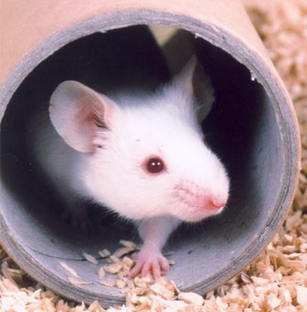

Mice Found Dead with Malocclusion
Not pursued as non-compliance
What happened?
Mice have been found dead. On observations of cadavers, the mice had well-established malocclusion.
Why did we have to report it?
It could have breached PEL SC 4.5.
What did we learn?
Mice are sometimes only accounted for within the nest or fun tunnel and not expected to move. This means it becomes very easy to miss an animal that is suffering.
Mice are prey animals and will behave normally until they no longer can.
There are some scenarios, such as this, when the grimace scale alone is not a sufficient assessment tool to determine the presence of welfare issues.
It is essential to ensure mice have a full body assessment during their AM checks.
There is sometimes a misconception that malocclusion is a rapidly occurring disorder.
Malocclusion is a slow and progressive disorder that occurs over weeks rather than days.
It is vital that our daily AM checks capture differences in mouse physique and behaviour to prevent the ongoing progression of malocclusion as early as possible to ensure mice do not suffer unnecessarily.
What did we change?
As standard practice, any person that performs a task that results in an animal experiencing an adverse welfare impact, and/or unnecessary suffering is re-assessed and where necessary re-trained.
If mice are not seen for a full body check, outside of the nest or fun tunnel:
  Technicians will return to the cage by the end of the row being checked to attempt a second check.
  If still unable to see the mice fully the cage is taken to the change station and opened.
SOPs are being drafted to ensure the inclusion of teeth checks for malocclusion or misalignment (134 Breeding set-ups – IVC facilities and 240 Health Checks).
NC3Rs resources are available and posters have been placed up in some rodent facilities https://www.nc3rs.org.uk/3rs-resources/malocclusion-mice
A bite-size malocclusion workshop is being created for Moodle and will be used to provide refresher training for all staff. All new inductees will also complete this workshop.

Slide 2
SC PEL Standard Conditions
4(5)
The health and well-being of protected animals, and the environmental conditions in all parts of the establishment where animals are kept, shall be checked at least once daily by a competent person. Arrangements shall be made to ensure any defect discovered and any avoidable pain, suffering, distress or lasting harm discovered is eliminated as quickly as possible.

