Slide 1

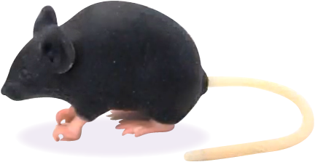
AWERB approved Guidance on
the process of training for:
Intravenous (IV) Injection Technique
for the administration of substances
The Ideal Route to take:
An appropriate PIL must be in place before any training
Competency must be achieved before one can move on to the next step.
This will be at the speed, discretion and opinion of the Trainer.
1. Practice on the Rat or Mouse plastic model
2. Practice on freshly killed cadavers
However, in exceptional circumstances there may be a cumulative experimental burden on study mice, or the lack of numbers/ availability of study mice.
An alternative route could be: (in yellow)
III. Train on Animals for Sch1 (Anaesthetised)
Schedule 1 of ASPA:
Table A, 1 - Overdose of an anaesthetic using a route and an anaesthetic agent appropriate for the size and species of animal – All animals
Completed, such as, by 1(c) dislocation of the neck.
3. Train on Study Animals (Controls)
IV. Train on Animals for Sch1
(Conscious)
4. Train on Study Animals (Experimental)
The HO requires the Sch1 method used to be the least invasive which invariably is cervical dislocation. Therefore before continuing AWERB request:
Complete training records and DOPS competency for Steps 1 and 2.
Trainer deemed likely good chance of success for Step III.
Gain NACWO +/- NVS approval to move to Step III.
Animal used has no prior isoflurane exposure, e.g., stock.
V. Train on Study Animals (Experimental)
VI. Competent
5. Passed as Competent
VII. Use Study Animals (Experimental)
UBS Top Tips for successful IV Training:
Practice needle and handling techniques on plastic models and cadavers first.
When using living (inc anaesthetised) animals, at the Trainer’s discretion, have a max of 2 attempts for the trainee then 1 for the Trainer to complete the task – totalling 3 attempts.
Alternate tail vein sides, and then move up the tail (towards the body), again at the Trainer’s discretion.
Consider the Saphenous vein, not tail vein, for blood sampling
Version 1 November 2021

