Slide 1
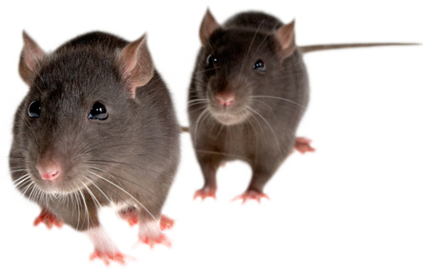
Colony Management and Breeding Calculations
UBS Colony Management Group 2021
Lisa Wright, UBS Training Centre, lw419@cam.ac.uk

Slide 2
Why Perform Breeding Calculations?
Produce a specific number of animals to fulfil researcher requests
Prevent over or under production
Colony expansion
Check breeding strategies
Find out when animals will be ready for experiments

Slide 3
Question
Type Y or N in the chat box to respond:
In your current role, are you responsible for devising breeding strategies?
Do you use breeding calculations to help with this?

Slide 4
Performing Breeding Calculations- Steps
Identify breeding data
Calculate the litter interval
Calculate offspring per female per week
Consider variation rates
Factor in economic breeding life (if continuous breeding required)
Think about turnover (if continuous breeding required)
Calculate required space

Slide 5
1. Identify breeding data
 | Mouse | Rat
Gestation period (g) | 3 weeks | 3 weeks
Oestrous cycle (c) | 1 week | 1 week
Average litter size | 6-8 | 6-8
Economic breeding life (ebl) | 6 litters/ 6 months | 6 litters/ 6 months
Weaning age (w) | 3 weeks | 3 weeks

Slide 6
Calculate the litter interval
We use this formula to work out a reasonable litter interval
(75%)g + (25%) (c + g + w)
So, for a mouse:
75% of 3 = 2.25 25% of (1 + 3 + 3 = 7) = 1.75
The litter interval is: 2.25 + 1.75 = 3 weeks

Slide 7
Calculate offspring per female per week
Litter size/ litter interval
Litter size = 6
Litter interval = 3
6 / 3 = 2 So, the offspring per female per week is 2
If you require only males, or only one genotype, you can amend this based on the probability of producing that animal e.g. If only males are required and we assume 50:50 sex ratio, divide by two.

Slide 8
Consider variation rates
This puts in a margin of error to compensate for animals not performing to ‘average’ expectations
Because the impact of poor performance is greater across smaller colonies, we stagger the margin of error as below:
Total number of cages in colony | Add this percentage to the total number of pairs required
10s of cages (0-100 cages) | +15%
100s of cages (100-1000 cages) | +10%
1000s of cages (1000 cages +) | +5%

Slide 9
Consider variation rates
Imagine we are using 10 pairs, what percentage would we add to allow for variation?
15 %.
So, we would add 1.5 cages... Or 2!
So in total, there would be 12 cages.

Slide 10
Factor in economic breeding life (EBL)
If you need to keep producing animals you need to think about EBL
Litter interval x EBL = 3 x 6 = 18
The breeding stock will need replacing every 18 weeks.
This is usually staggered to replace the older pairs an provide a continuous supply.
To do this we divide the number of pairs by the replacement time, so sticking with the 12 pairs from the previous slide, 12 / 18 = 0.6, so we’d replace 1 cage per week.

Slide 11
Factor in economic breeding life
We need to breed the additional animals to replace this stock.
We already know one female produces 2 pups, so if we need an additional pair per week, we need to add one more breeding cage.
This takes the total to 13 pairs.

Slide 12
Think about turnover and caging
Your researcher may need animals at a particular age
You may need to factor in this time and think about caging for weanlings until they are of experimental age
You will also need space for any surplus animals
You should have a strategy for making best use of surplus stock...
...And amend your colony accordingly if you are regularly producing too many animals

Slide 13
Monitoring progress
At each stage you should monitor your colony
Useful calculations:
Ave. litter size (animals born/ no. of pairs)
Ave weaned no. (animals weaned/ no. of pairs)
Percentage surplus (no. of surplus/number produced x 100%)
PWM rate: No. weaned /no. born x 100%)

Slide 14
That all sounds like a lot of work...
In reality, you probably won’t do full breeding calculations for each colony! What can you do?
Consider using calculations for specific colonies
Apply the principles, think about the data you know, e.g. litter intervals, ave. litter size, EBL
Apply the margin of error principle
Monitor your colony closely- if they’re poor breeders consider plug checking- don’t wait two weeks to identify failed pairings
Be proactive in applying changes based upon your monitoring
Communicate with your researchers

Slide 15
Advantages and Disadvantages of Breeding Calculations
Advantages
Disadvantages
Provides a guide of how many animals to set up etc.
Shows when animals will be ready
Gives an idea of how much space will be required
Can adjust for poor breeders by changing breeding data used
Gives researchers some ‘evidence’ of your strategy
Can be useful for costing
Assumes animals will perform true to the breeding data used
Not exact science! Can still be wrong

Slide 16
Application to a Bl/6 Breeding Colony
Managing a large WT colony can be a time when breeding calculations are useful
Not straightforward, there are a number of problems…

Slide 17
Problems to address in WT colonies
No clear idea of requirements- lots of users
Seen as an in-house resource, available on demand
Fluctuating requirements
Use of surplus animals
Genetic drift

Slide 18
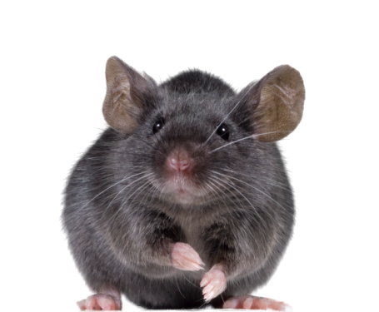
Any questions....?

