Slide 1
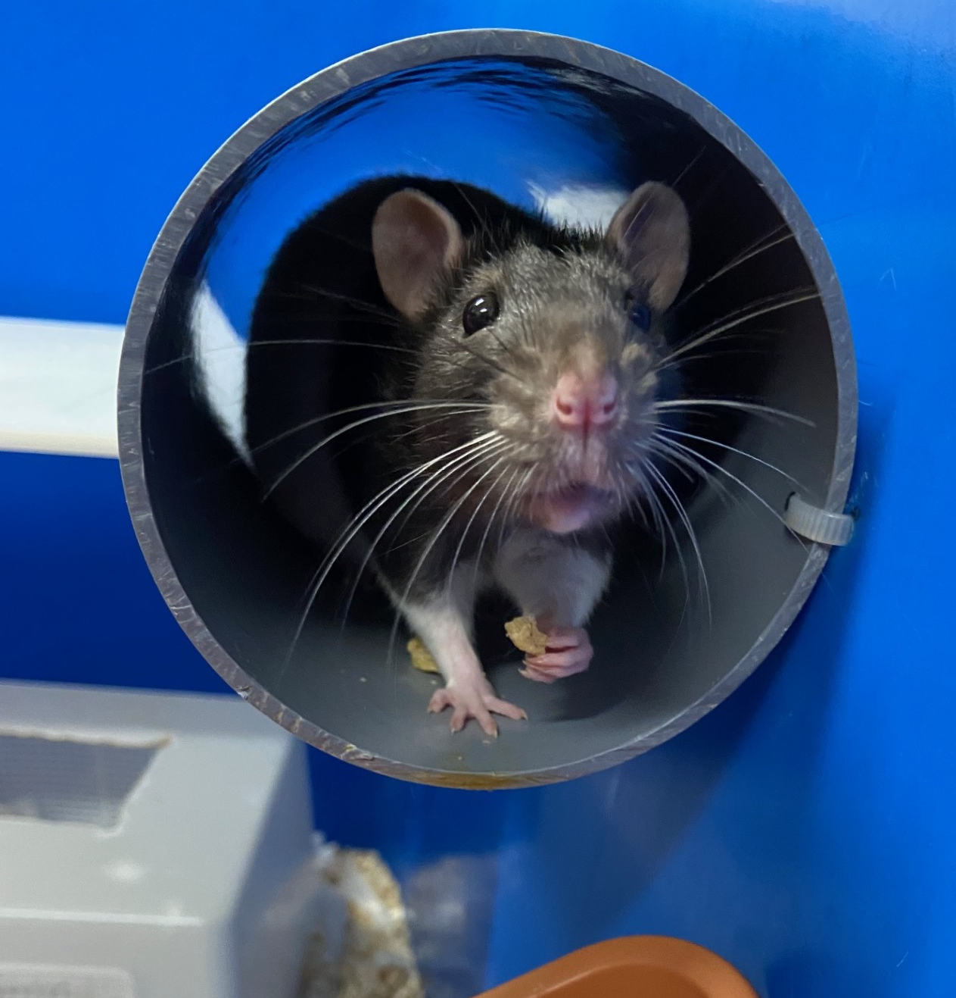
Named Information Officer (NIO)
AWERB Training Day
25th November 2025
University Biomedical Services

Slide 2
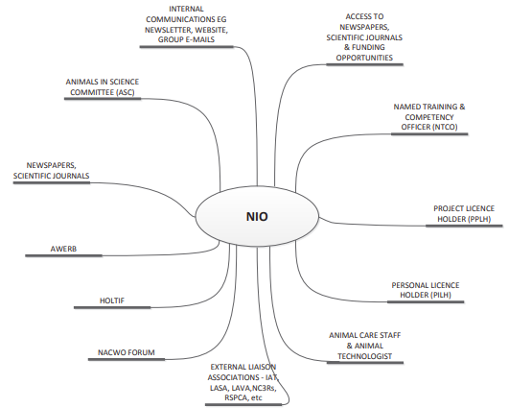

The role of the Named Information Officer (NIO)
Notes:
These LASA guiding principles helps us to identify what and how the NIO role should be covered. This spider diagram demonstrates our working matrix. That fulfils the requirements for the NIO role as set out by ASPA.

Slide 3
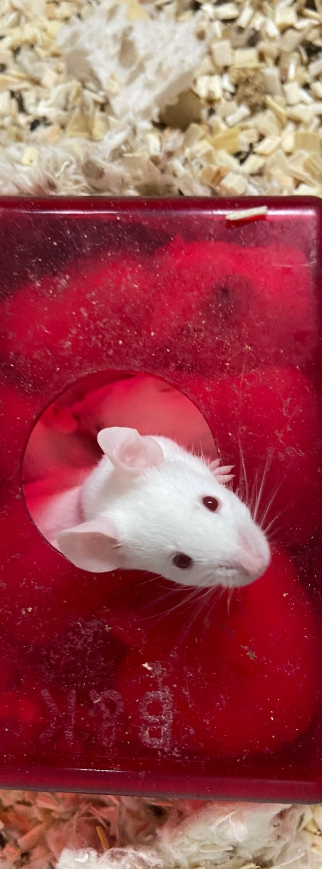
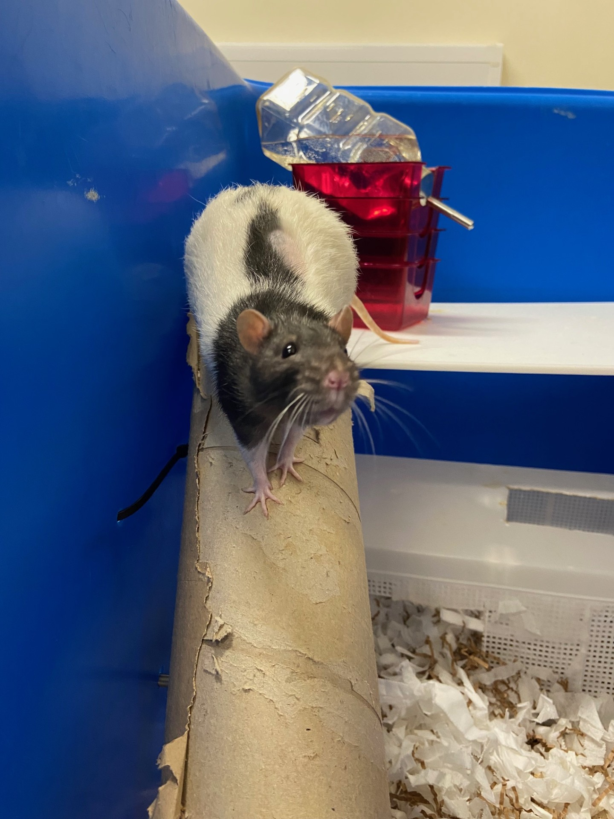
An overview of what NIOs do at UBS
Contribute to AWERB and other meetings
Newsletters
and bulletins
Create posters
Collate and report on SC18s
Support rehoming of animals
3Rs drop ins
Promotion of openness
Public engagement
A point of contact for all
Help create guidance
Teaching
IAT & HO
Disseminate information
Notes:
This is just a quick overview of what we cover at UBS.
Many of these items relate to AWERB in one way or another.

Slide 4
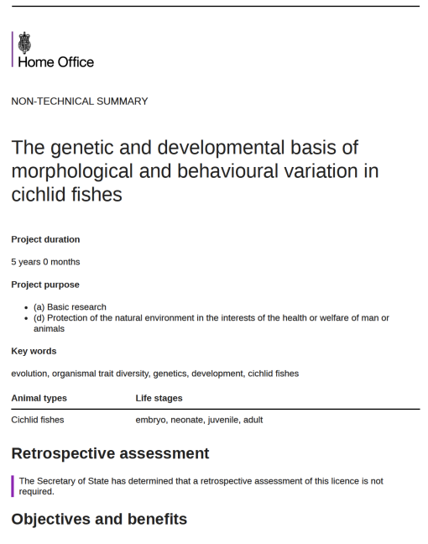
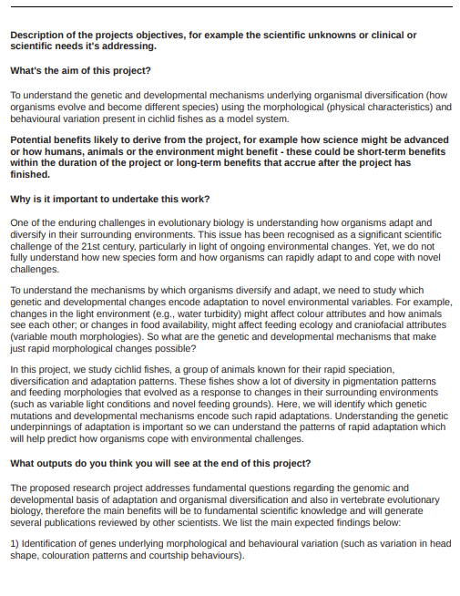

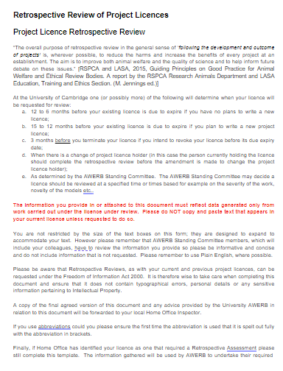
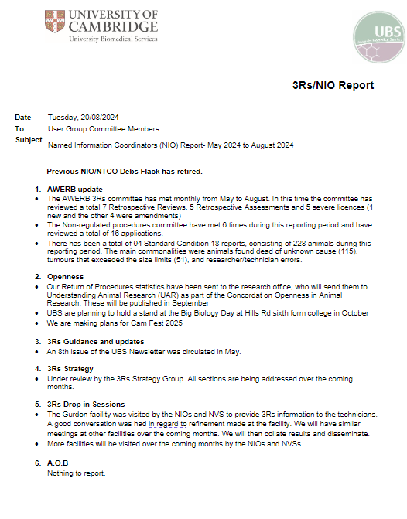
Animal Welfare and Ethical Review Body Committee Meetings
We provide advice and support to:
AWERB Standing and Sub-Standing
AWERB Operations Committee
Non-regulated Procedures Committee
AWERB 3Rs Committee
We also consider and provide feedback for all Retrospective Review and Assessments of project licences
Notes:
We have 4 committees that meet monthly.

Slide 5
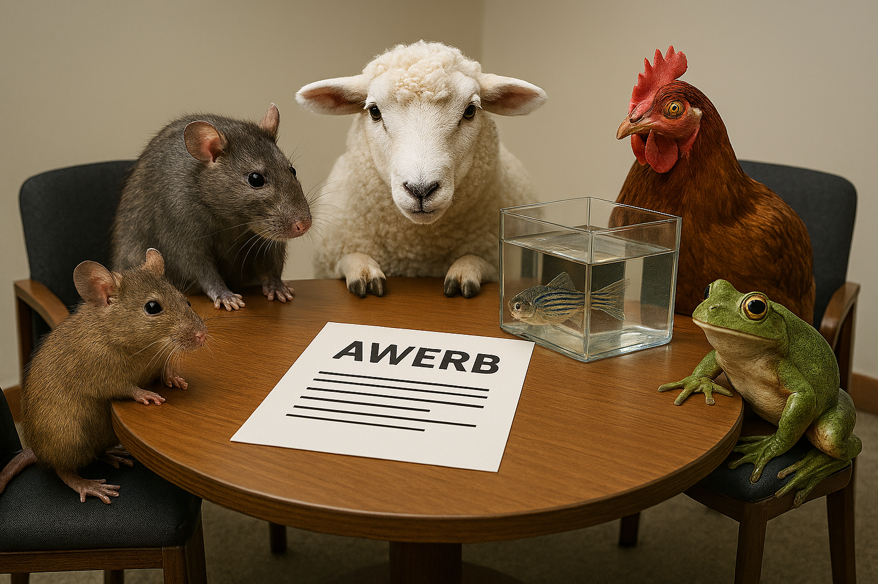
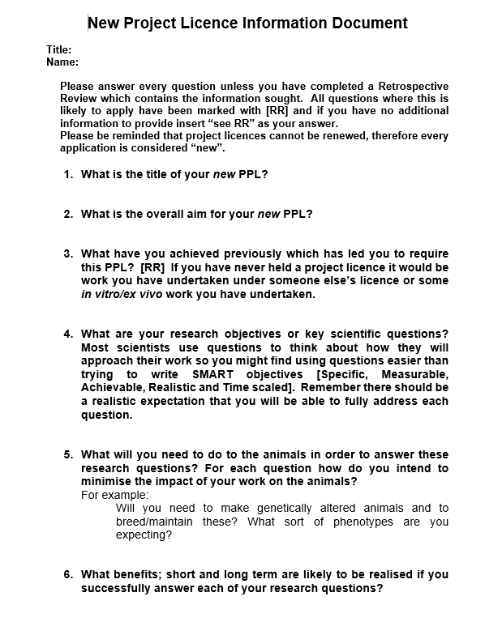
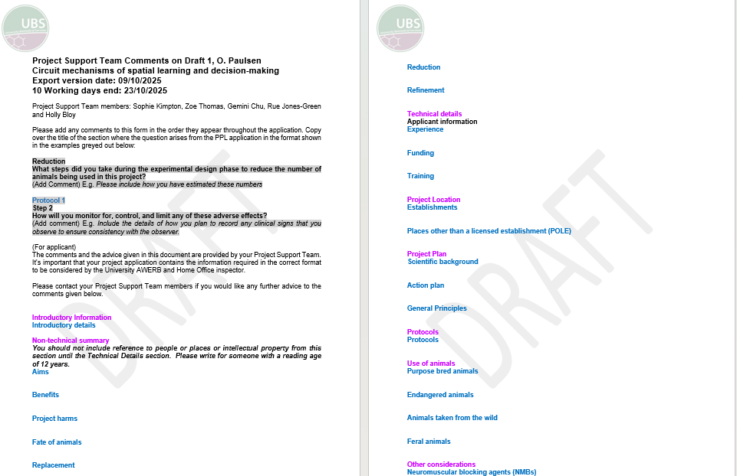
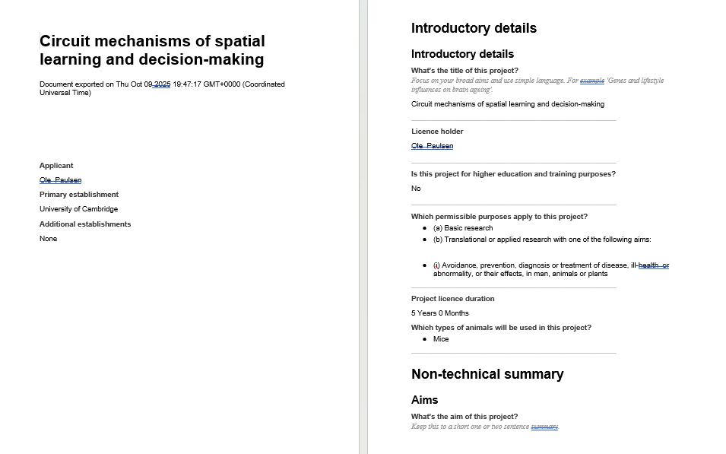
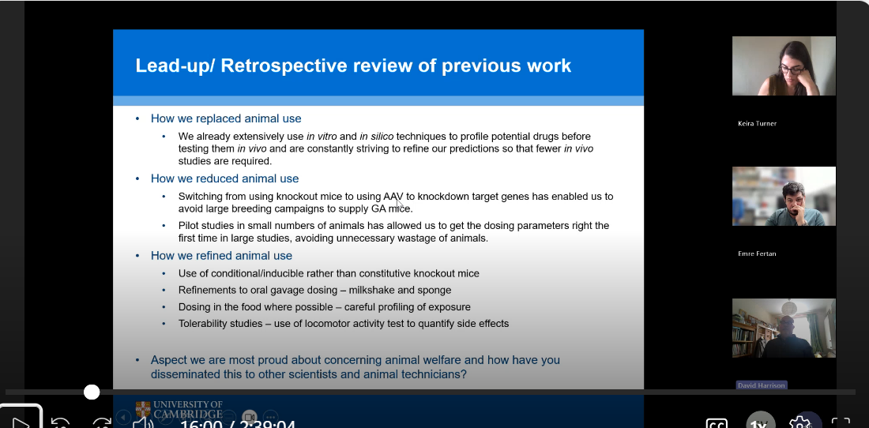

Project Licence Support
NTS and Animal Experience in protocols (PST)
PPL’s presentation
3Rs section (initial meeting)
Notes:
We start at the beginning of PPL writing process, at part of the PST (Project support team) giving advise in the initial meeting about the 3Rs and where they can find information.
We then review their drafts of their PPL, mainly focusing on the NTS where we are looking at the animal experience, cost/benefit and the 3Rs sections. Making sure all are understood for a lay reader and if we feel they need resources or advise we can help to provide that information.
Lastly, we attend AWERB. The licence is usually in a very good condition, so often there are few comments as most have been dealt with during the PST. However often there are things in the PPLs presentation that were not in their licence.

Slide 6
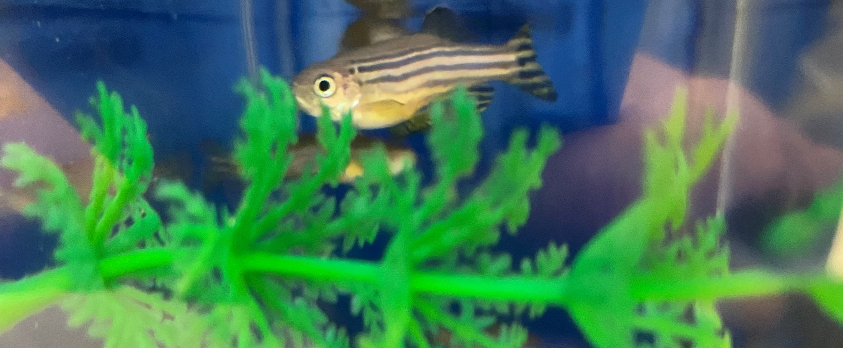
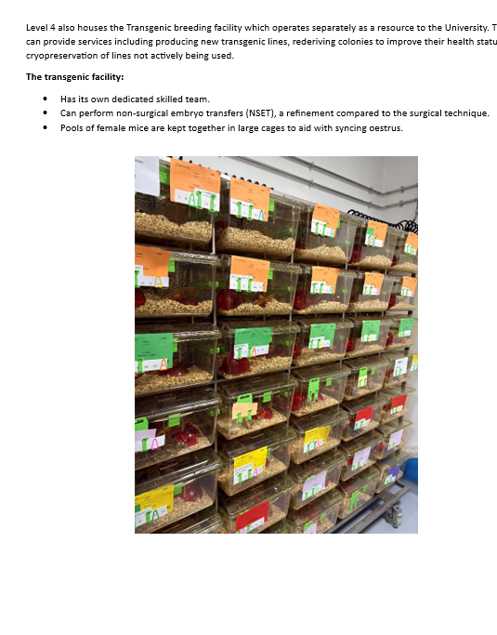
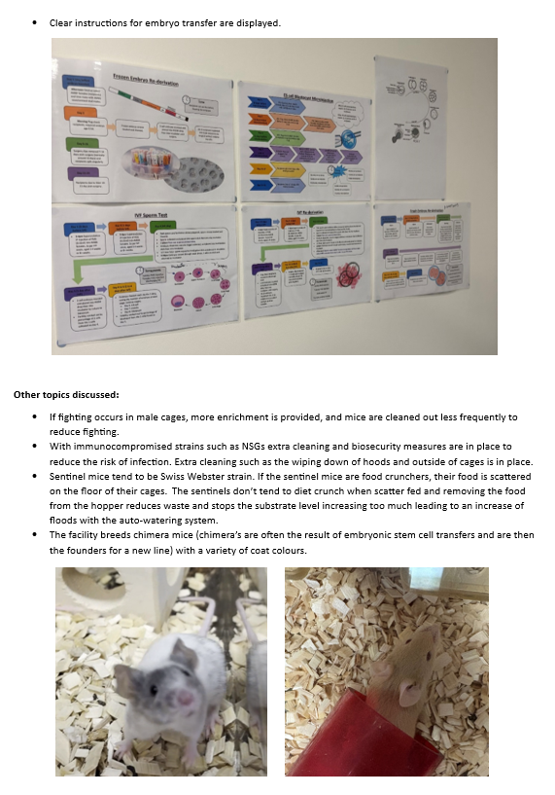
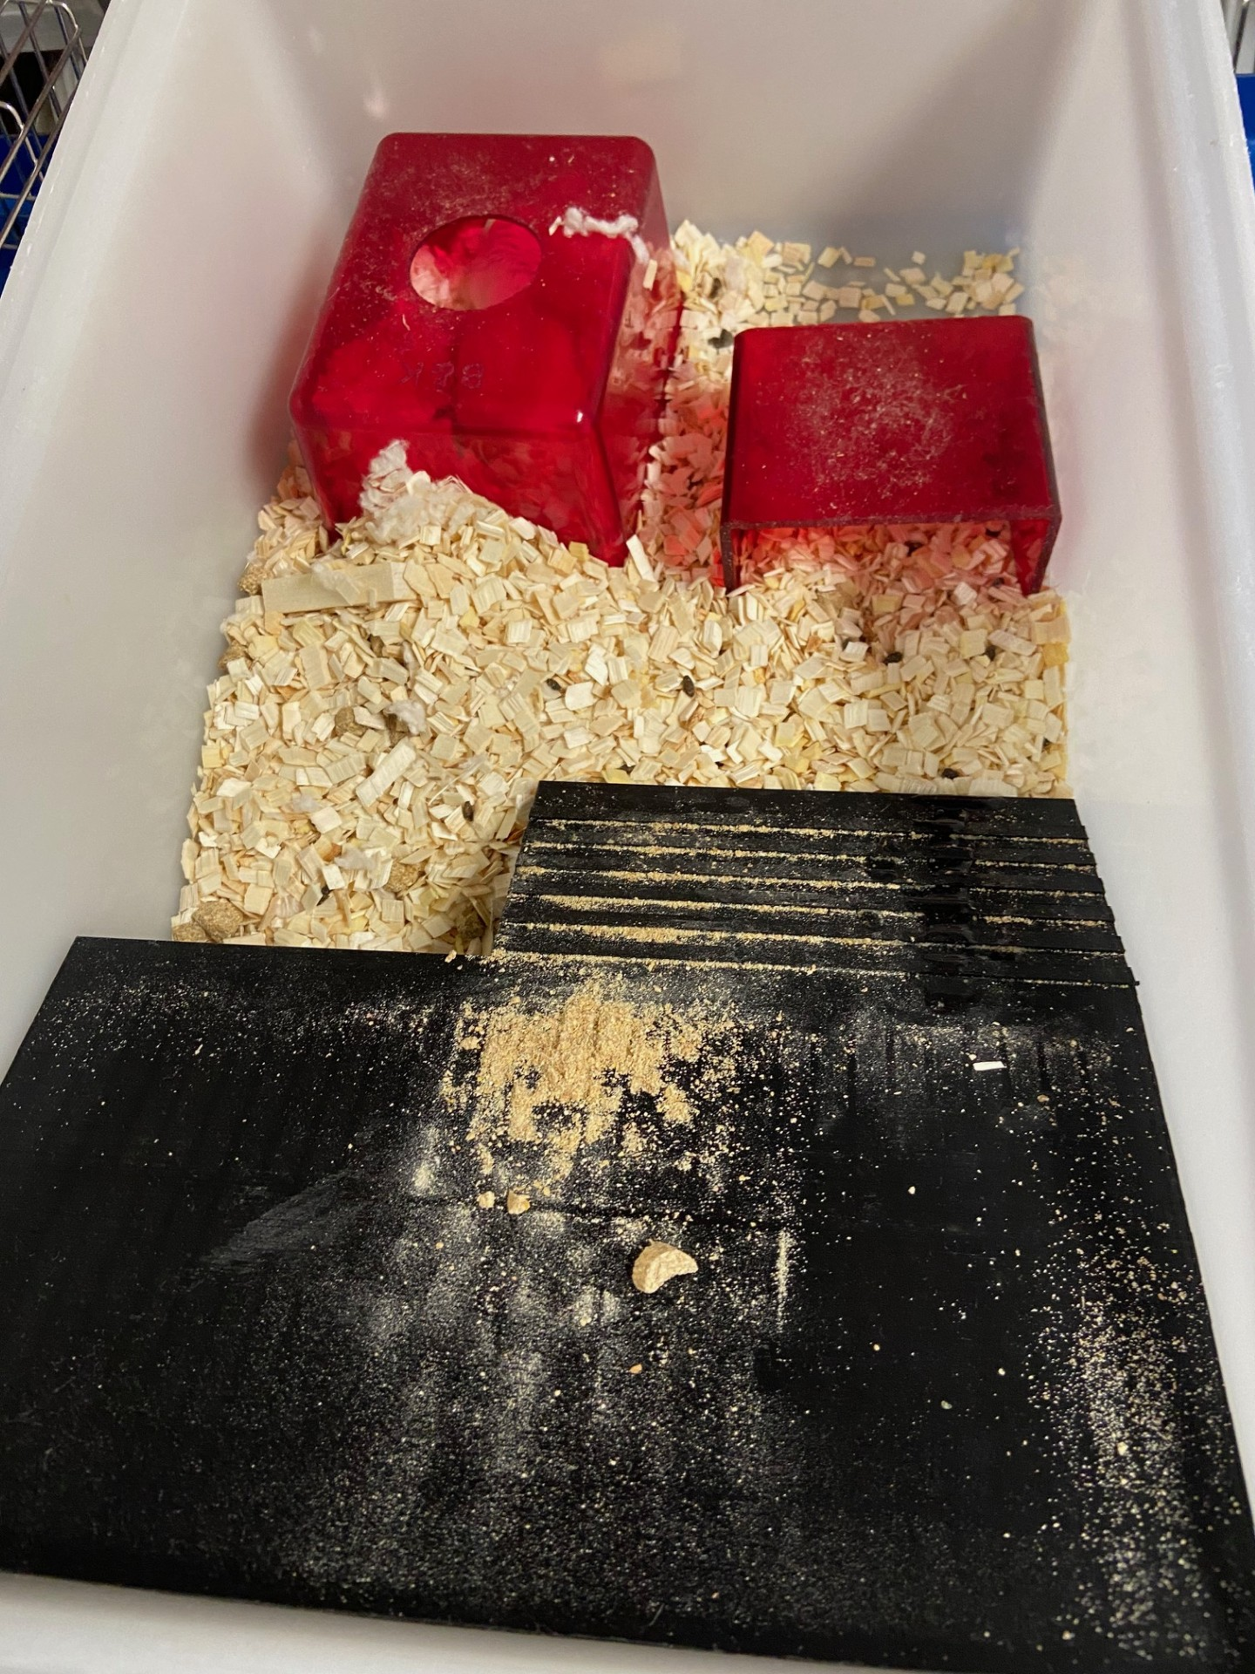
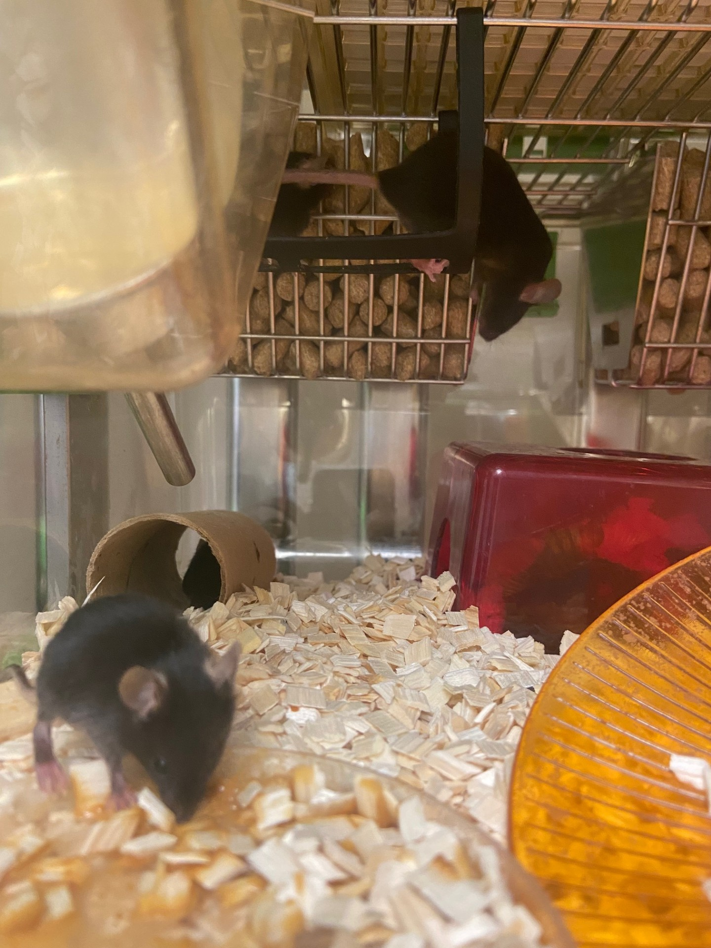
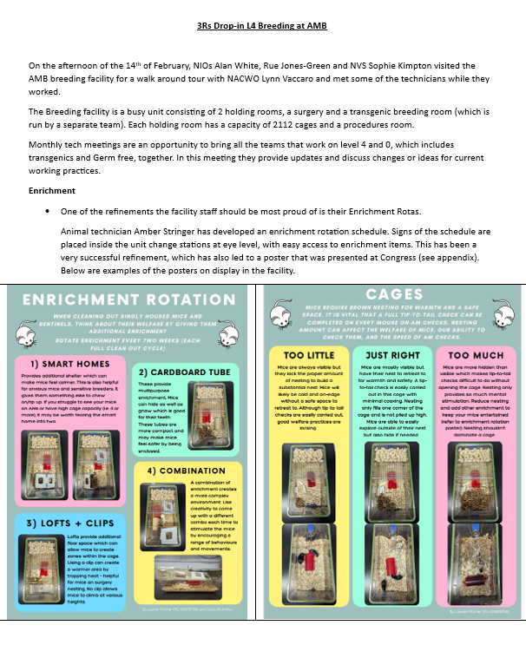
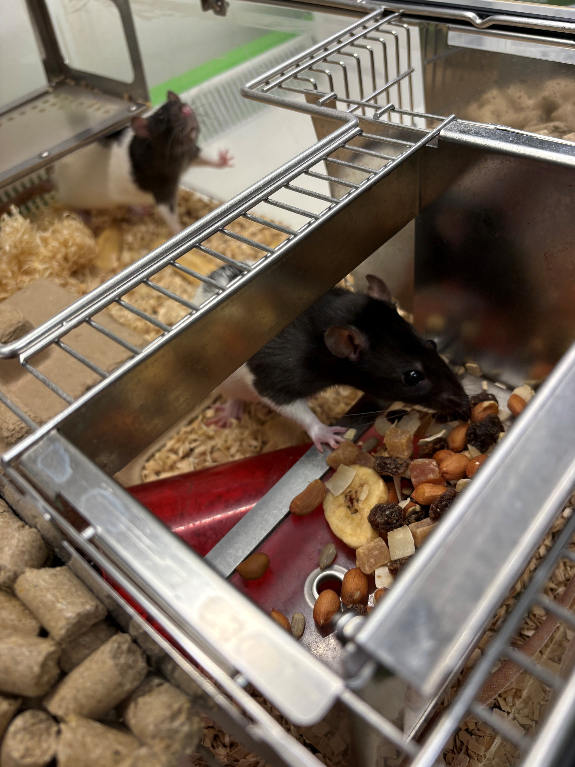
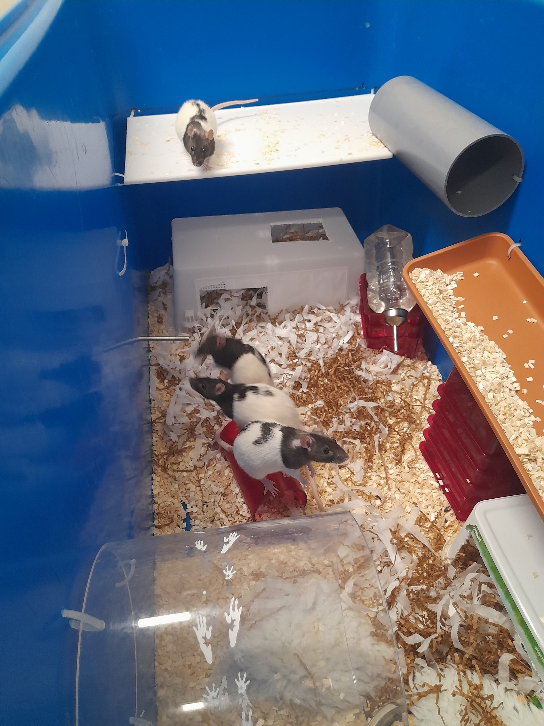
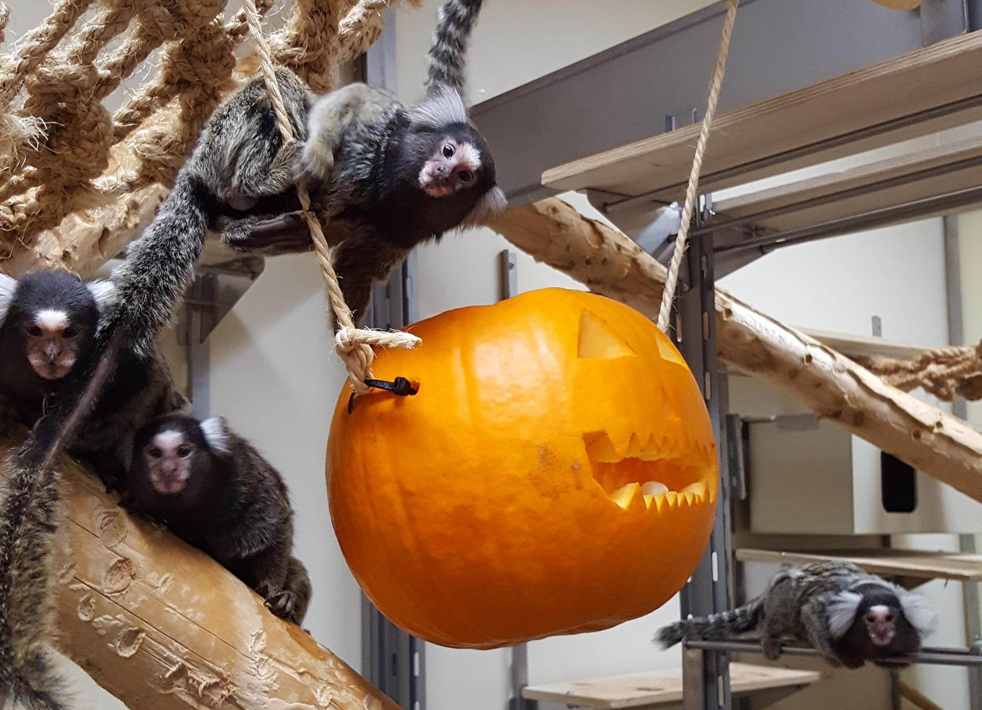
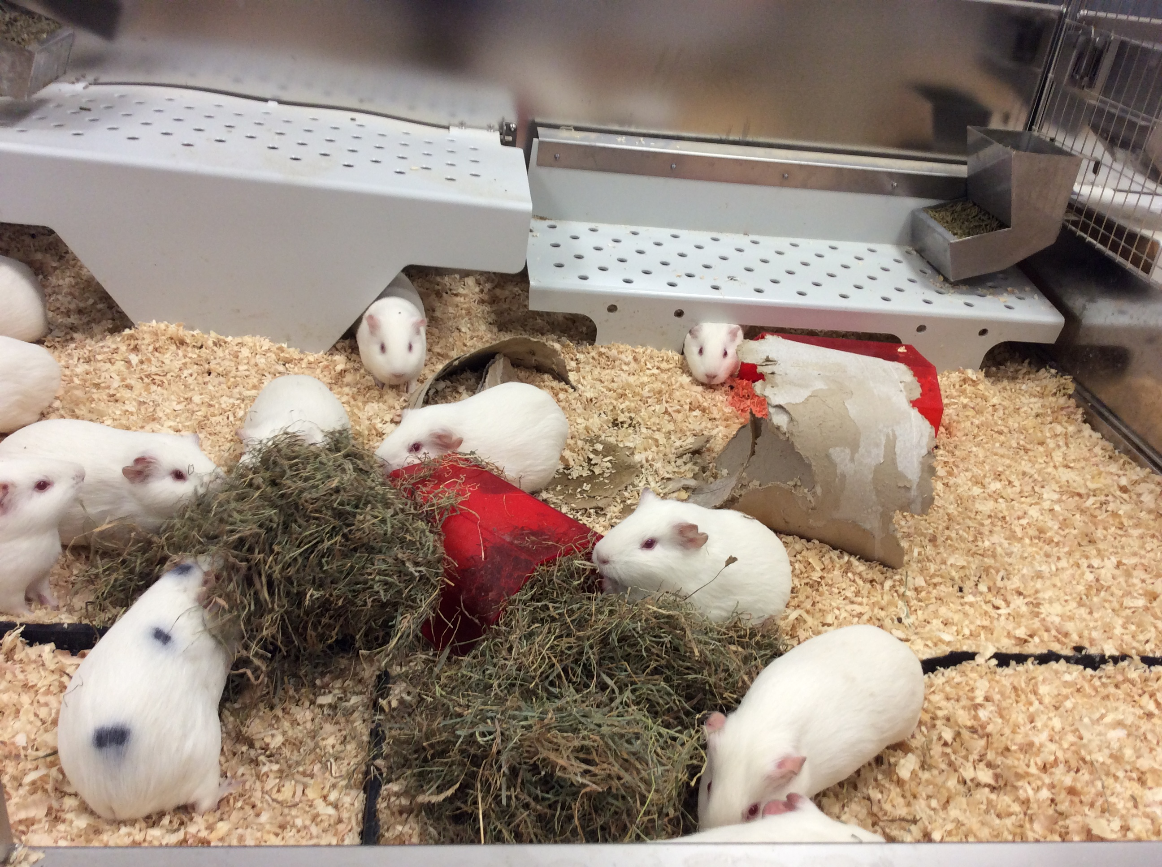
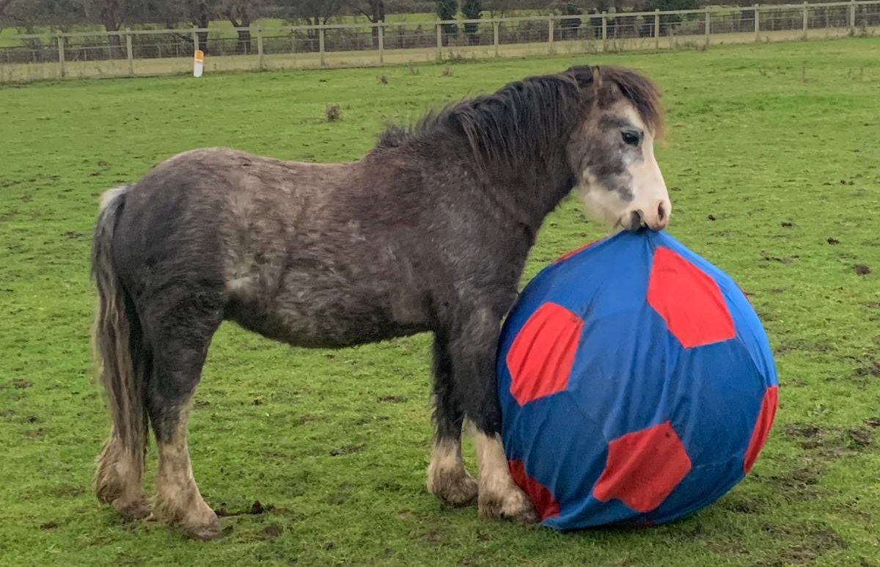
3Rs Drop Ins
We visit units to discuss how they implement the 3Rs. Reports are sent to the AWERB 3Rs Committee for comment.
Notes:
We visit facilities to talk with technicians as look at refinements in place. Often excellent refinements are being carried out due to our high levels of animal care. These can then be discovered and added to the report. Eventually we will collate all the refinements to share more widely.

Slide 7
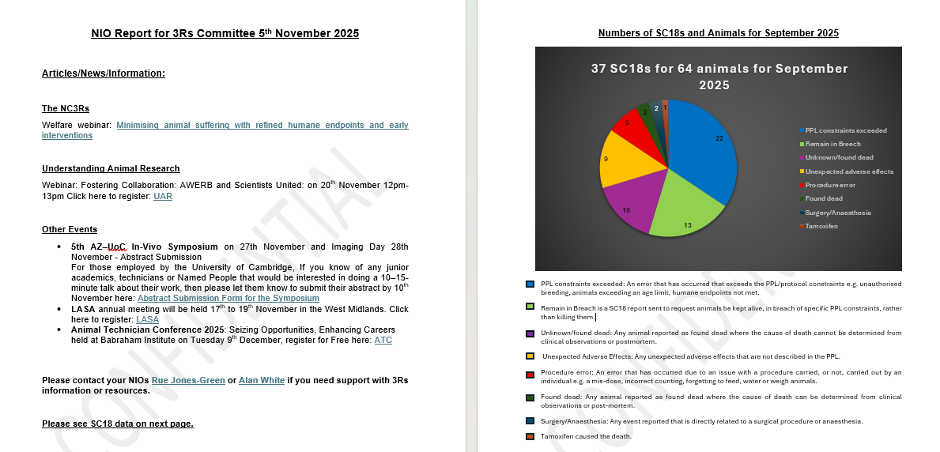
3Rs NIO reports
New information
Events
3Rs Drop in report
SC18 report
Notes:
The NIO reports that we submit to the 3Rs meeting contains any new information regarding up coming events (such as meetings, courses or conferences), any new processes or findings in the field of the 3Rs, and anything we think relevant that should be raised at the meeting.
We also provide a report on the SC18s that have been submitted for the given month.

