Slide 1
AWERB Training Day
Introduction

Slide 2
What is AWERB and Named Persons
What’s the legal requirement of:
  AWERB
  Named Roles
Terms of Reference
The aim for today

Slide 3


What does AWERB stand for..
A
W
E
R
B
Animal
Welfare
Ethical
Review
Body
Notes:
AWERB stands for Animal Welfare Ethical Review Body. Running an AWERB is a legal requirement for all UK establishments that use, breed or supply animals for scientific procedures under the Animals (Scientific Procedures) Act 1986. AWERBs provide comprehensive consideration of all ethical issues, an essential component in maintaining good animal (and staff) welfare.

Slide 4
What is an AWERB and what are Named Persons?
All establishments that use, breed or supply animals for scientific procedures under ASPA are required to establish an AWERB.
In addition, all project licences must specify Named Persons responsible for the roles defined in ASPA. These are the Named Veterinary Surgeon (NVS), the Named Animal Care and Welfare Officer (NACWO), the Named Training and Competency Officer (NTCO), the Named Information Officer (NIO) and the Named Person Responsible for Compliance (NPRC)
Notes:
The role of the AWERB is to promote welfare and the uptake of the 3Rs of animal research (Replacement, Reduction, Refinement), to provide advice on project proposals and to approve all project licence applications prior to their submission to the Establishment Licence Holder and ASRU.

Slide 5
What is the legal requirement of AWERB under ASPA?
‘Advise the staff dealing with animals on matters related to the welfare of animals, in relation to their acquisition, accommodation, care and use’
‘Advise the staff on the application of the requirement of replacement, reduction and refinement, (3Rs) and keep them informed of technical and scientific developments concerning the application of that requirement’
‘Establish and review internal operational processes as regards to monitoring, reporting and follow-up in relation to the welfare of animals housed or used in the establishment’
‘Follow the development and outcome of projects, taking into account the effect on the animals used, and identify and advise with regards to elements that further contribute to replacement, reduction, and refinement’
‘Advise on rehoming schemes, including the appropriate socialisation of the animals to be rehomed.’

Slide 6
An effective AWERB should:
Take a lead role in promoting animal welfare and the responsible care and use of animals used at the Establishment e.g. improvements in housing, husbandry and procedures
Foster a good culture of care
Provide advice on the Project Licence application process
Conduct retrospective reviews
Address ethical and welfare concerns and disseminate any learning associated with this
Improve confidence (including public confidence) in the need for and quality of, scientific work and care provided at the Establishment

Slide 7
Named People at our establishment
A person to be responsible for overseeing the welfare and care of the animals kept at the place specified in the licence (Named Animal Care and Welfare Officers); we have 18 across all facilities
A veterinary surgeon with expertise in laboratory animal medicine, or other suitably qualified person, to provide advice on the welfare and treatment of those animals (Named Veterinary Surgeon); we have 4
A person to be responsible for ensuring that the persons dealing with those animals have access to any information they need about the species concerned (Named Information Officer); we have 2
A person to be responsible for ensuring that the persons dealing with those animals are adequately educated and trained and are supervised until they have demonstrated the requisite competence (Named Training and Competency Officer); we have 6
A person to be responsible for ensuring that the conditions of the licence are complied with (Named Person Responsible for Compliance) this is the ELH.
Notes:
The Act says we must have the following people in roles at our establishment.

Slide 8
What is a Terms of Reference
Terms of Reference (ToR) is a formal document that outlines the scope, objectives, and structure of a project or initiative, ensuring clarity and alignment among stakeholders
We also cover membership of each meeting, the role/remit of each, monthly standing items, annual standing items, Agenda items of report, frequency of the meeting and the reporting lines
There is a minimum attendance required for each meeting to make it quorate
It also sets out our committee organogram
Terms of Reference (TOR) | University Biomedical Services (UBS)
Notes:
Quorate meetings. They can not take place if the listed members are not available to attend. Having dedicated administrators who manage all the admin that comes with holding these meetings is key to a successful AWERB and all subsequent meetings thereafter. Meeting dates are set a year in advance to ensure correct reporting lines are met, and that diaries can be coordinated for those who’s attendance is mandatory.

Slide 9
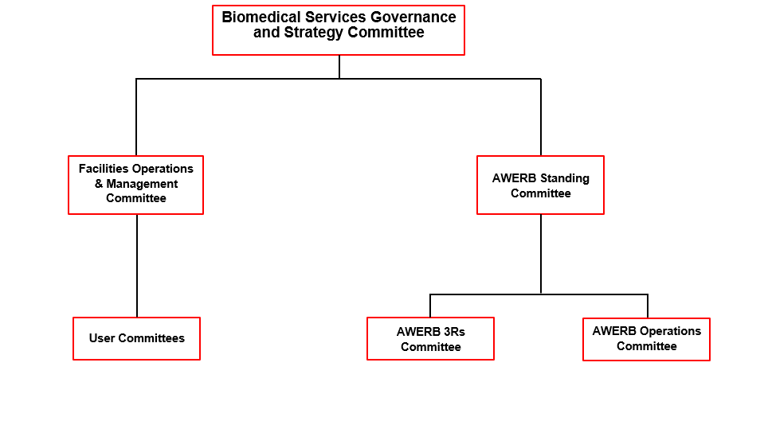
Biomedical Services Committee Structure
Notes:
Biomedical Services Committee Structure. This organogram sets out where AWERB sits within the Governance framework. AWERB Standing committee encompasses 5 smaller bespoke meetings which we’ll come on to later.

Slide 10
Aim for the day
Find out how much you know
Set a baseline for all our AWERB members in terms of knowledge
Empower you to have confidence in your role on the committee and with your peers
Find out if we’ve achieved that by your answers to our closing questions!

