Slide 1


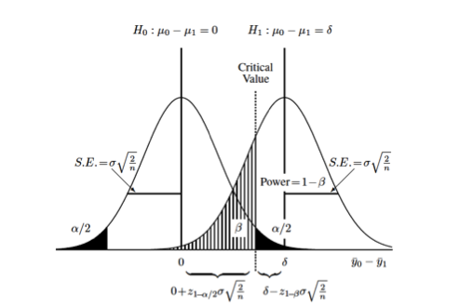


Experimental Design
AWERB Training Day
25th November 2025
University Biomedical Services

Slide 2
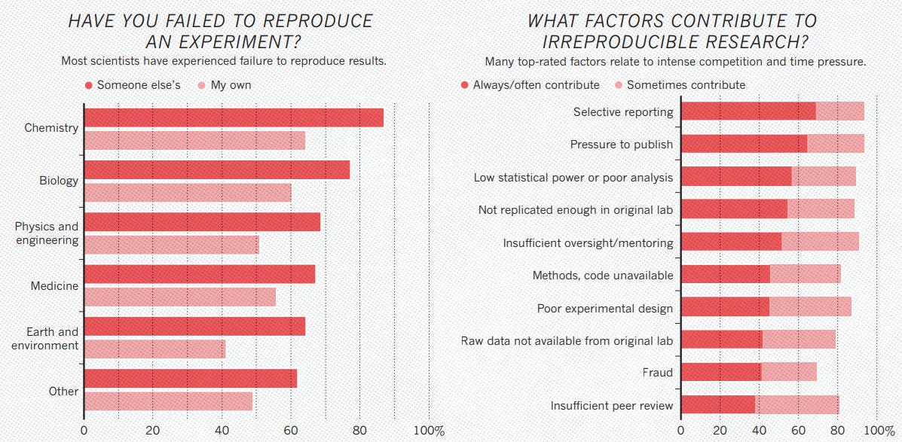
1,500 Scientists Lift the Lid on Reproducibility
Baker, M. 1,500 scientists lift the lid on reproducibility. Nature 533, 452–454 (2016).

Slide 3
What Are the 3 Key Elements of Experimental Design?
Power Analysis - the probability that the study will correctly detect a real biological effect if one exists i.e. determine if the results are statistically significant. Also used to determine sample size i.e. numbers of animals required.
Randomisation - ensures that any known and unknown covariates introducing bias are randomly distributed over the experimental groups.
Blinding - ensures that researchers are unaware of group allocation during the preparation, execution and acquisition and/or the analysis of the data.
Randomisation and blinding ensure that findings within a study can be attributed to the tested intervention with a higher confidence, by reducing the risk of bias.
Verhave P, van Eenige R, Tiebosch I. Methods for applying blinding and randomisation in animal experiments. Laboratory Animals. 2024;58(5):419-426.

Slide 4

Other Key Elements of Experimental Design
Pilot study - a small-scale preliminary investigation, or a "trial run“, conducted to test the feasibility and design of a larger, full-scale study.
Sex as a biological variable - a move away from the historical bias of using only male subjects in preclinical and clinical research accounting for biological sex in study design, analysis and reporting.
Access to a biostatistician - advice from a statistician gives confidence that studies will
  have an optimal design.
Karp, N.A., et al. The Sex Inclusive Research Framework to address sex bias in preclinical research proposals. Nat Commun 16, 3763 (2025).

Slide 5

Why is Experimental Design Important?
Reproducibility - demonstrates results are not due to bias or chance, are reliable and valid. Ensures transparency, accountability and ultimately trust in the scientific process.
Ethics, Welfare & 3Rs - ensures optimum numbers of animals are used, minimises the need to repeat studies, thereby, avoiding additional use of animals experiencing pain, suffering, distress or lasting harm without realising expected benefits.

Slide 6
Experimental Design and the PPL
Non-Technical Summary > Reduction
    How have you estimated the numbers of animals you will use?
    What steps did you take during the experimental design phase to reduce the number of animals
    being used in this project?
    What measures, apart from good experimental design, will you use to optimise the number of
    animals you plan to use in your project?
Applicant information > Experience
    What experimental design and data analysis training have you had?
Protocols > Experimental design
    Questions on experimental design including power analysis calculations

