Slide 1

NTCO role in AWERB
University Biomedical Services

Slide 2
NTCO ASPA responsibilities
“responsible for ensuring that all those dealing with animals are adequately educated, trained and supervised until they are competent and that they continue to undertake appropriate further training to maintain their expertise”
“oversee the process, making sure that training is taking place, that standards are acceptable and that a consistent approach is being adopted and delivered”

Slide 3
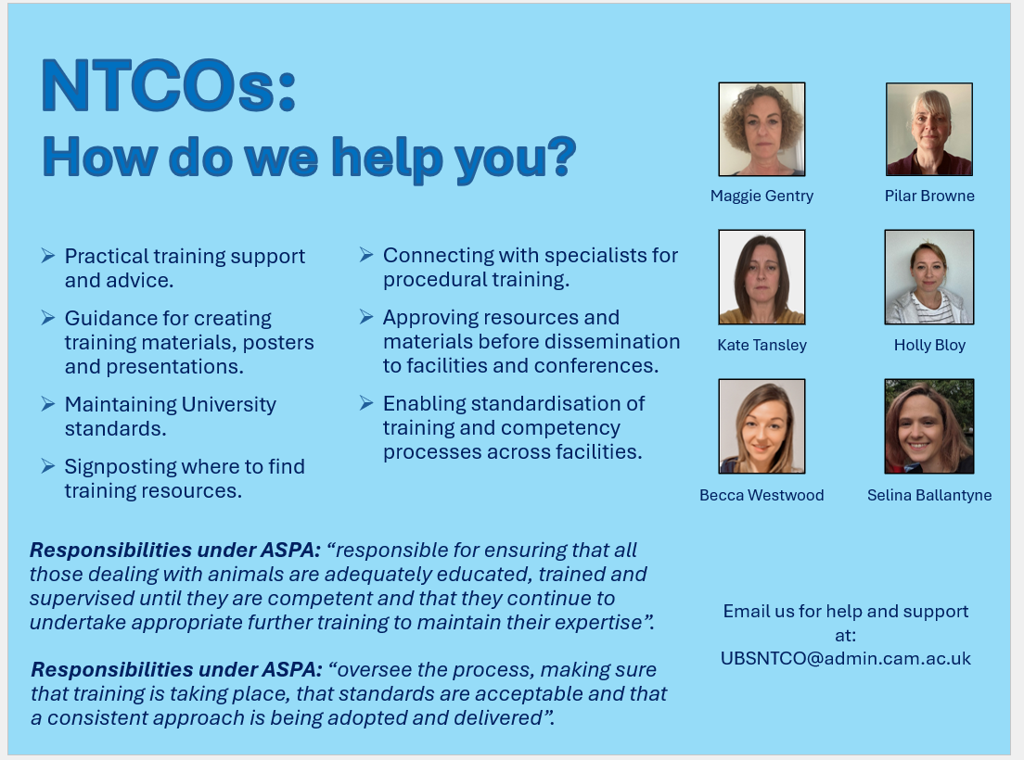
NTCO role at UBS
We carry this out by:
Providing guidance and review training materials, posters and presentations.
Signpost to resources when information might be needed or to a specialist when someone would like to learn a new procedure.
Streamline processes in each of the facilities
Can be reached on a group email address which
is on the UBS website and on the NTCO poster!

Slide 4

NTCO as an AWERB committee member
We sit on two AWERB committees, the AWERB Operations Committee (AOC) and the AWERB 3Rs committee, where we may ask questions about competency or new procedures.
We may suggest resources that are useful and pass on specialist contacts when needed.

Slide 5
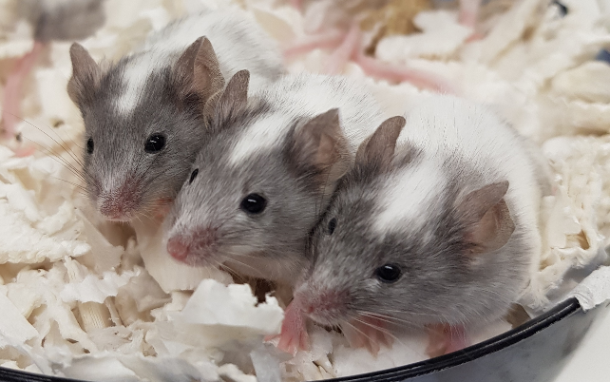
Potential Non-Compliance / RCA’s
  The RCA’s identify gaps in training, assessment or SOPs.
  Following the meeting we write up a report and list the appropriate actions that were agreed during the meeting.
  The reports are sent to the Home Office, and we on forward the Home Office outcome to the group involved once received.
  The number of RCA incidences are reported on at the AWERB Operations Committee (AOC).
We also lead the Root Cause Analysis (RCA) meetings which are held when someone reports a potential non-compliance. These can come to us via a SC18 report where we carry out the meeting to support the research group or from the facility NACWO.

