Slide 1

Licence Manager role in AWERB
University Biomedical Services

Slide 2
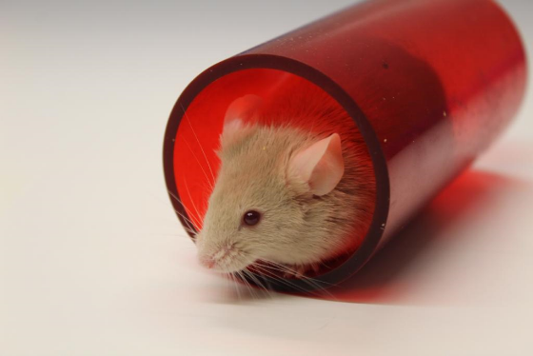
The Licence Manager and Head of Licencing roles
There are 3 Licence Managers and a Head of Licencing at UBS who support either new or existing PPL holders in writing their new licence.
We provide support throughout the process from the initial meeting just with us, to the Project Support Team meetings with us, the NACWO, NVS and NIO, through the drafting process and collating comments, to AWERB and finally to submission to the Home Office.

Slide 3
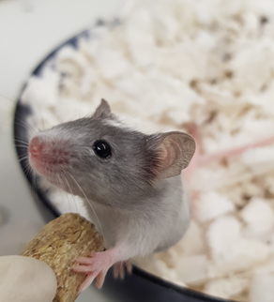
Licence Manager role
The time taken at each stage can vary depending on the application.
The PST meeting will also include feedback on the Retrospective Review (RR) or Retrospective Assessment (RA) if the applicant is a current PPL holder with UBS, before the RR/RA is submitted to AWERB.
The review of the new application could be completed on the 1st, 2nd and sometimes 3rd draft if necessary. The licence managers collate all the PST members comments into helpful feedback for the PPL holder.
The licence managers will then book the application into AWERB and following the AWERB meeting draft the letter which includes the comments from the committee to make any final changes before the PPL holder submits to the Home Office.

Slide 4
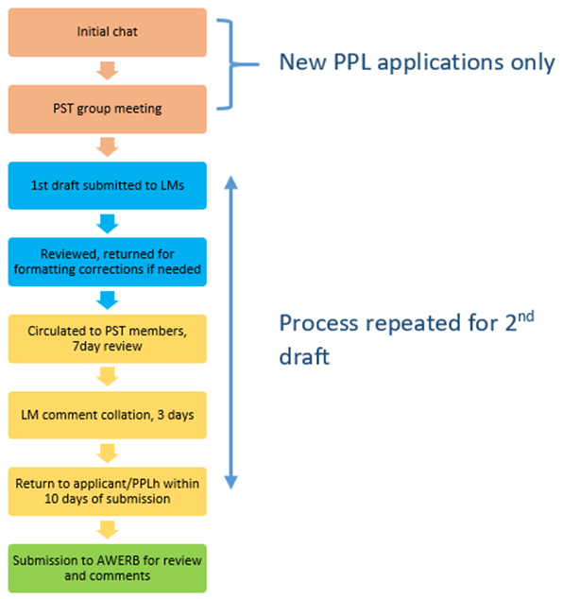
Throughout the process we keep an eye on timelines to ensure the PPL is approved by the Home Office in time to allow continuity from the previous PPL where this applies.
Licence Manager role

