Slide 1

NVS role in AWERB
University Biomedical Services

Slide 2
NVS ASPA responsibilities
Establish programme of veterinary care and health monitoring and advise on biosecurity, quarantine and health screening
Day-to-day involvement in safeguarding animal welfare
Monitor health and welfare by regularly visiting all areas
Thorough knowledge of housing, husbandry and welfare needs of species kept at the establishment
Supply and use of prescription drugs
Keep good health records
Advise on transport, breeding programmes, surgery, analgesia, anaesthesia, euthanasia
Impact of procedures on animals, and use of drugs for scientific purposes
Recognising signs of pain and distress, and how to minimise severity of protocols.
Regular communication with Named People
Involvement with AWERB
“The NVS is responsible for, monitors and provides advice on the health, welfare and treatment of animals and
should help the establishment licence holder fulfil their responsibilities.”
Guidance on the Operation of ASPA

Slide 3
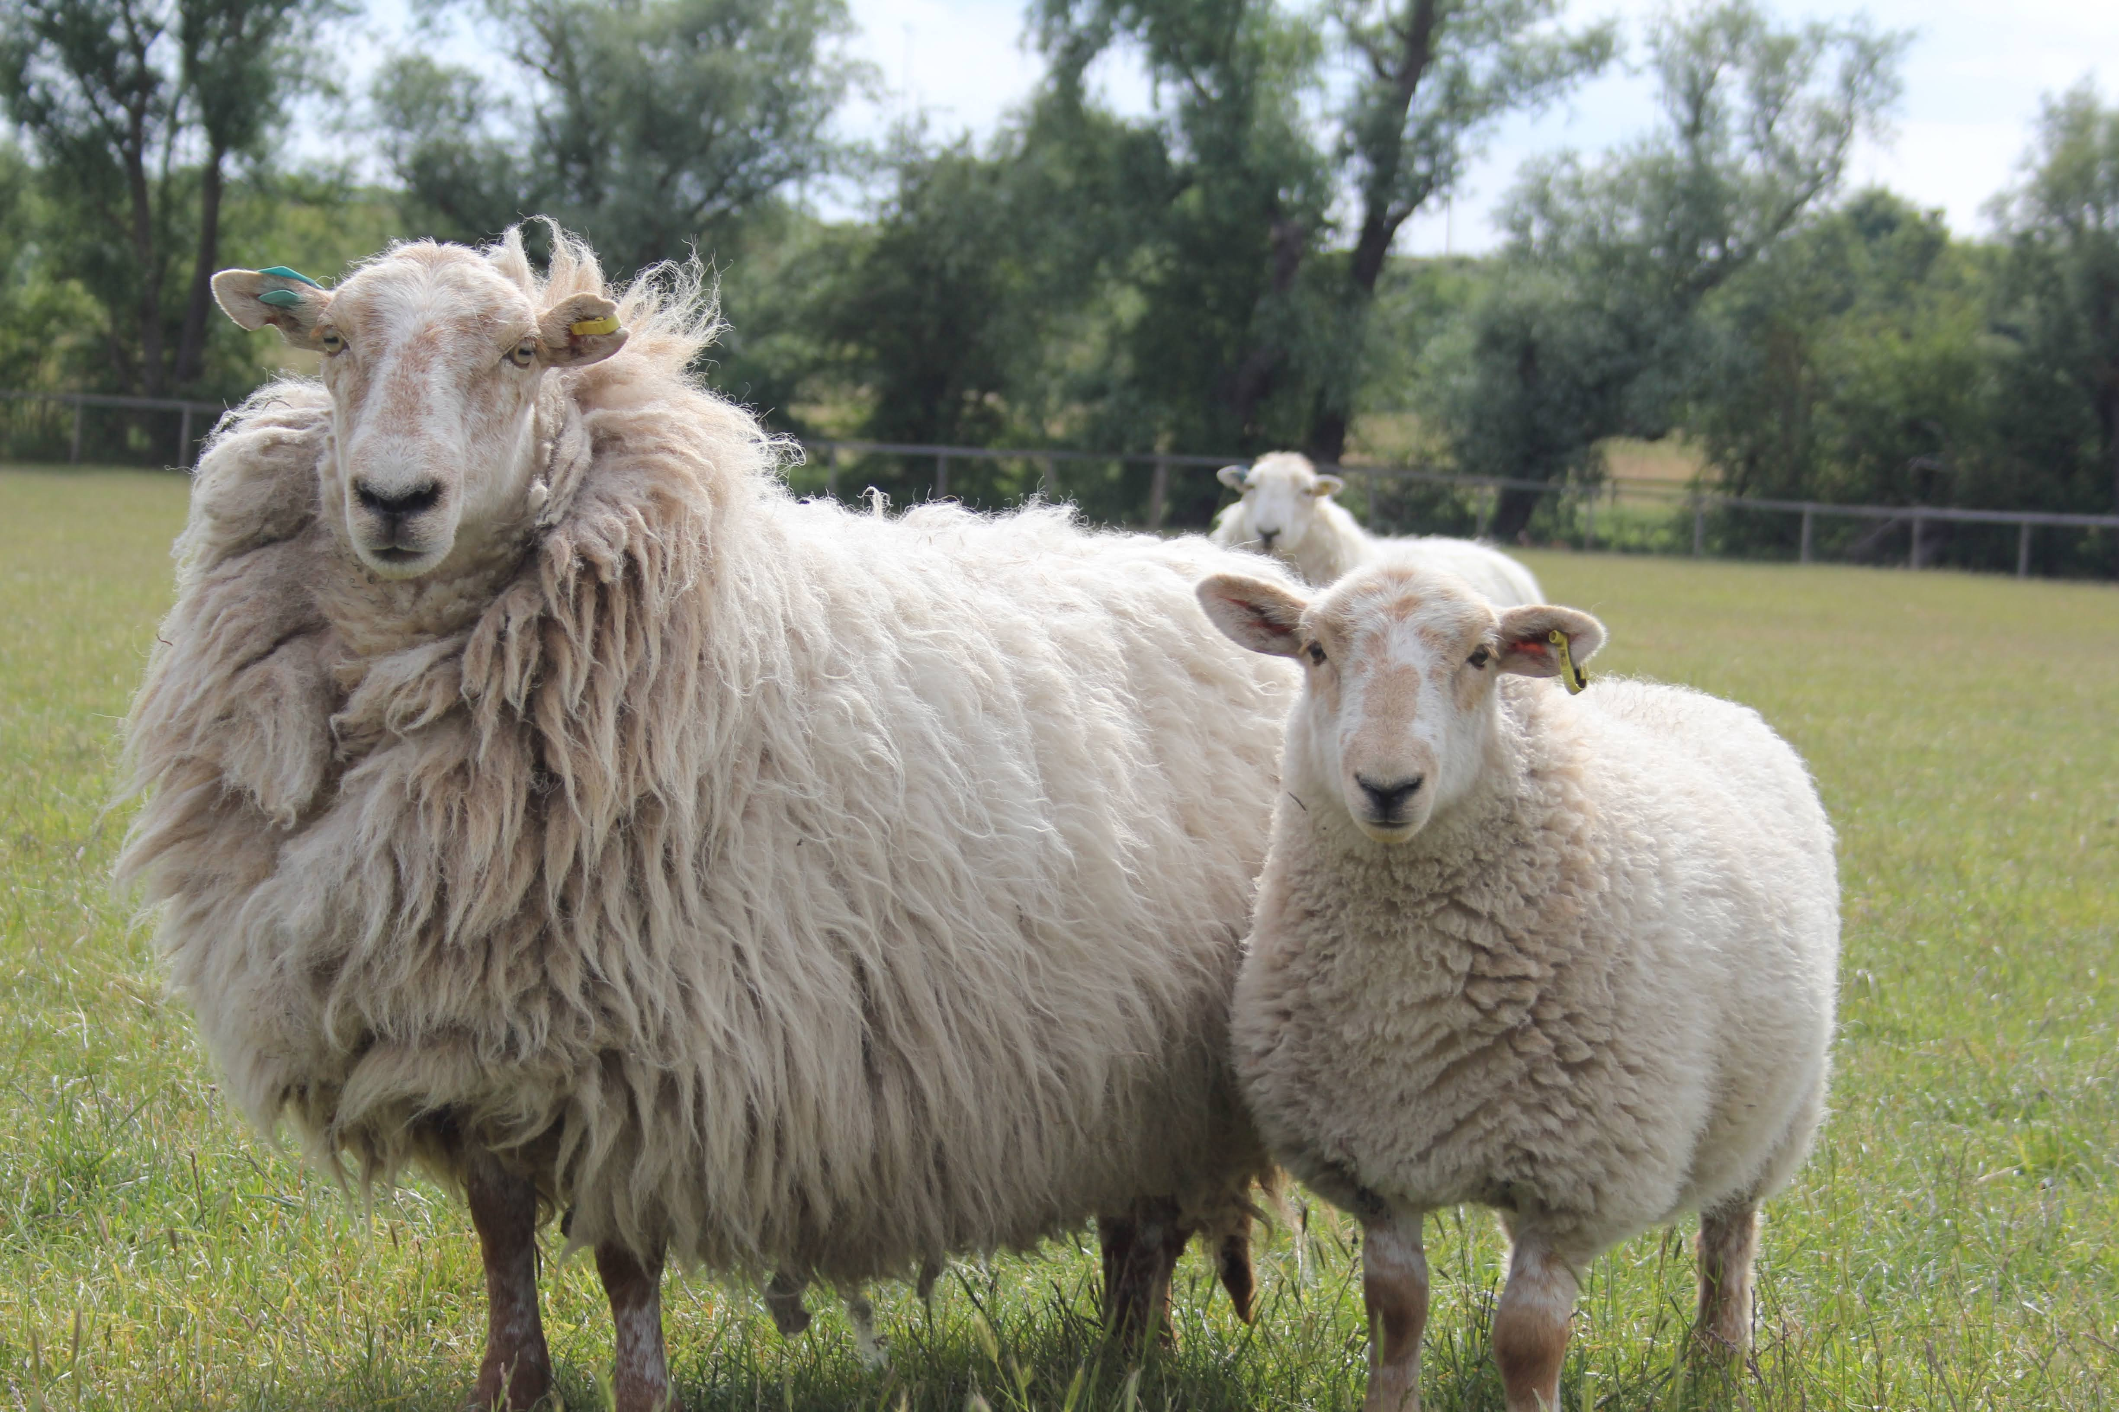
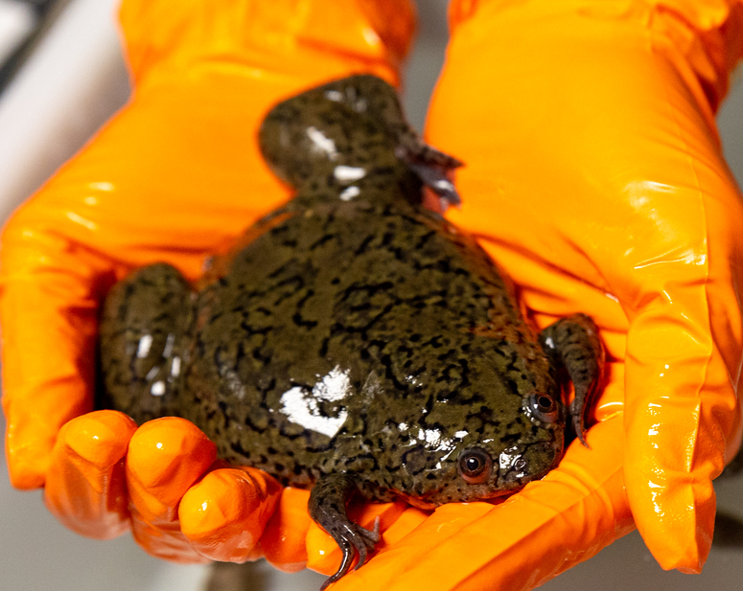
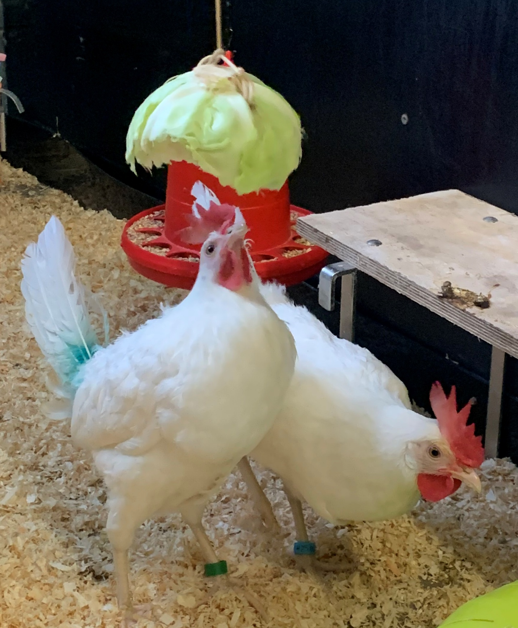
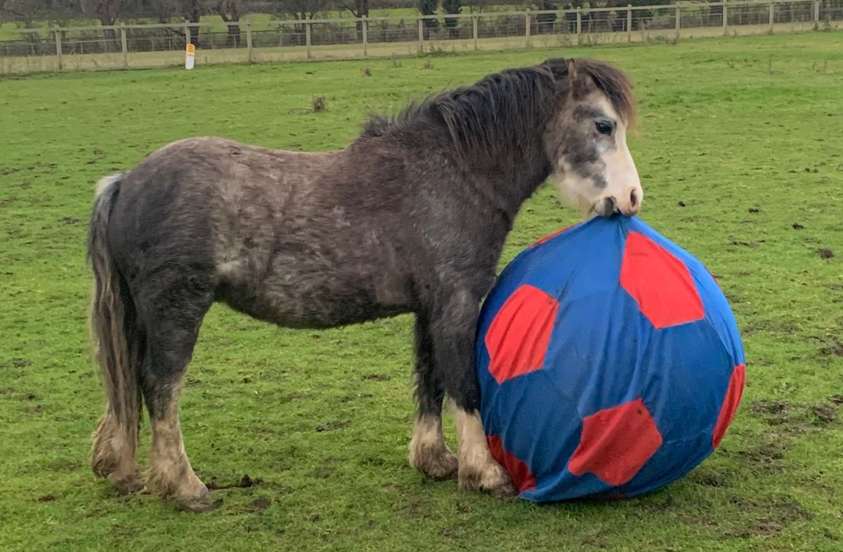
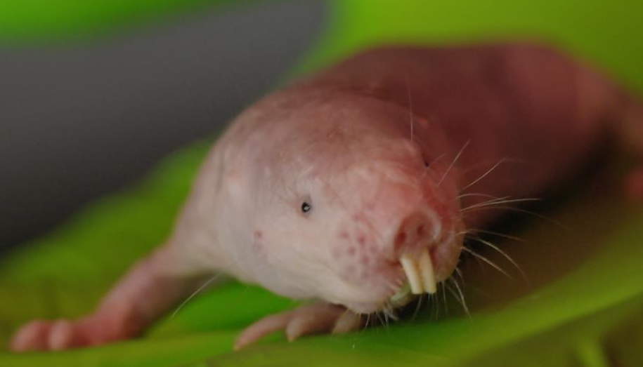
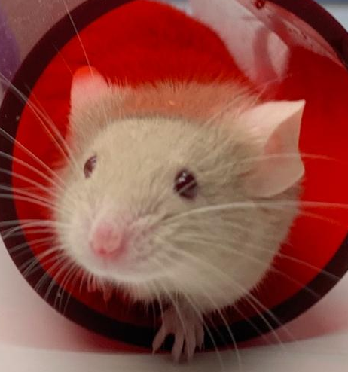
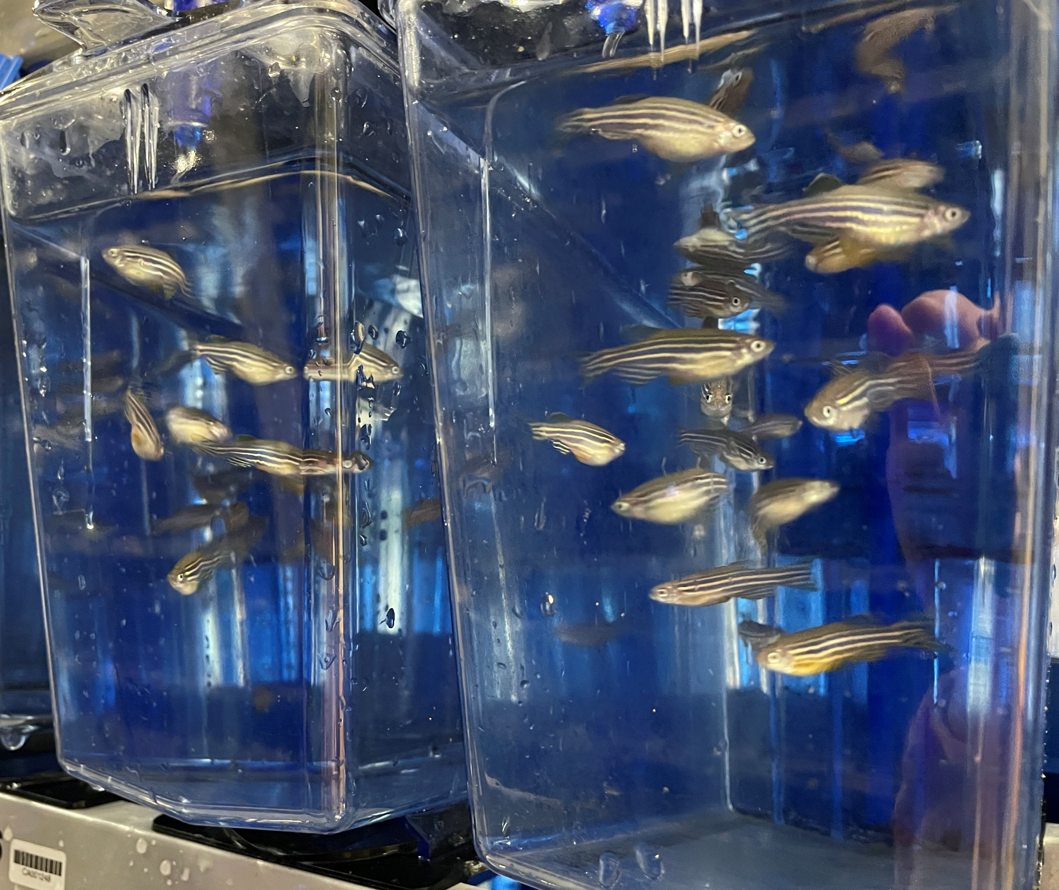
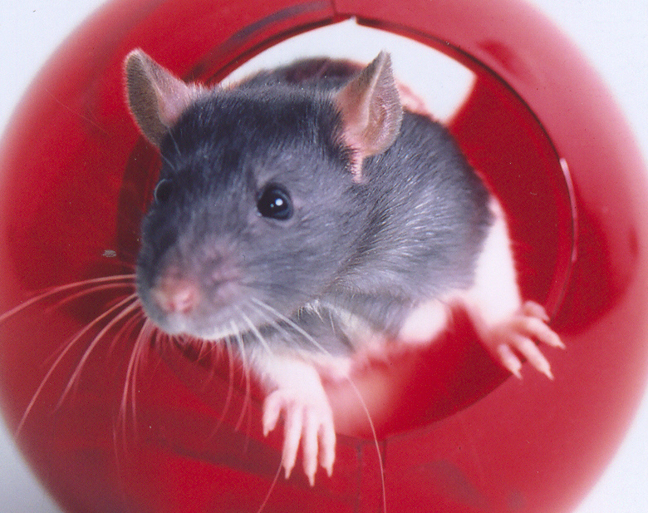
NVS role at UBS
Day-to-day:
Advise on individual clinical cases
Routine visits to facilities and general advice
AWERB Committees: Standing, Sub-standing, 3Rs, Antibody, AOC
Project Support Teams
Teaching – surgery and anaesthesia, species specific
Less often:
Health screening and biosecurity plans
Reuse checks and rehoming
Import and export checks and advice
Guidance and Strategy documents

Slide 4
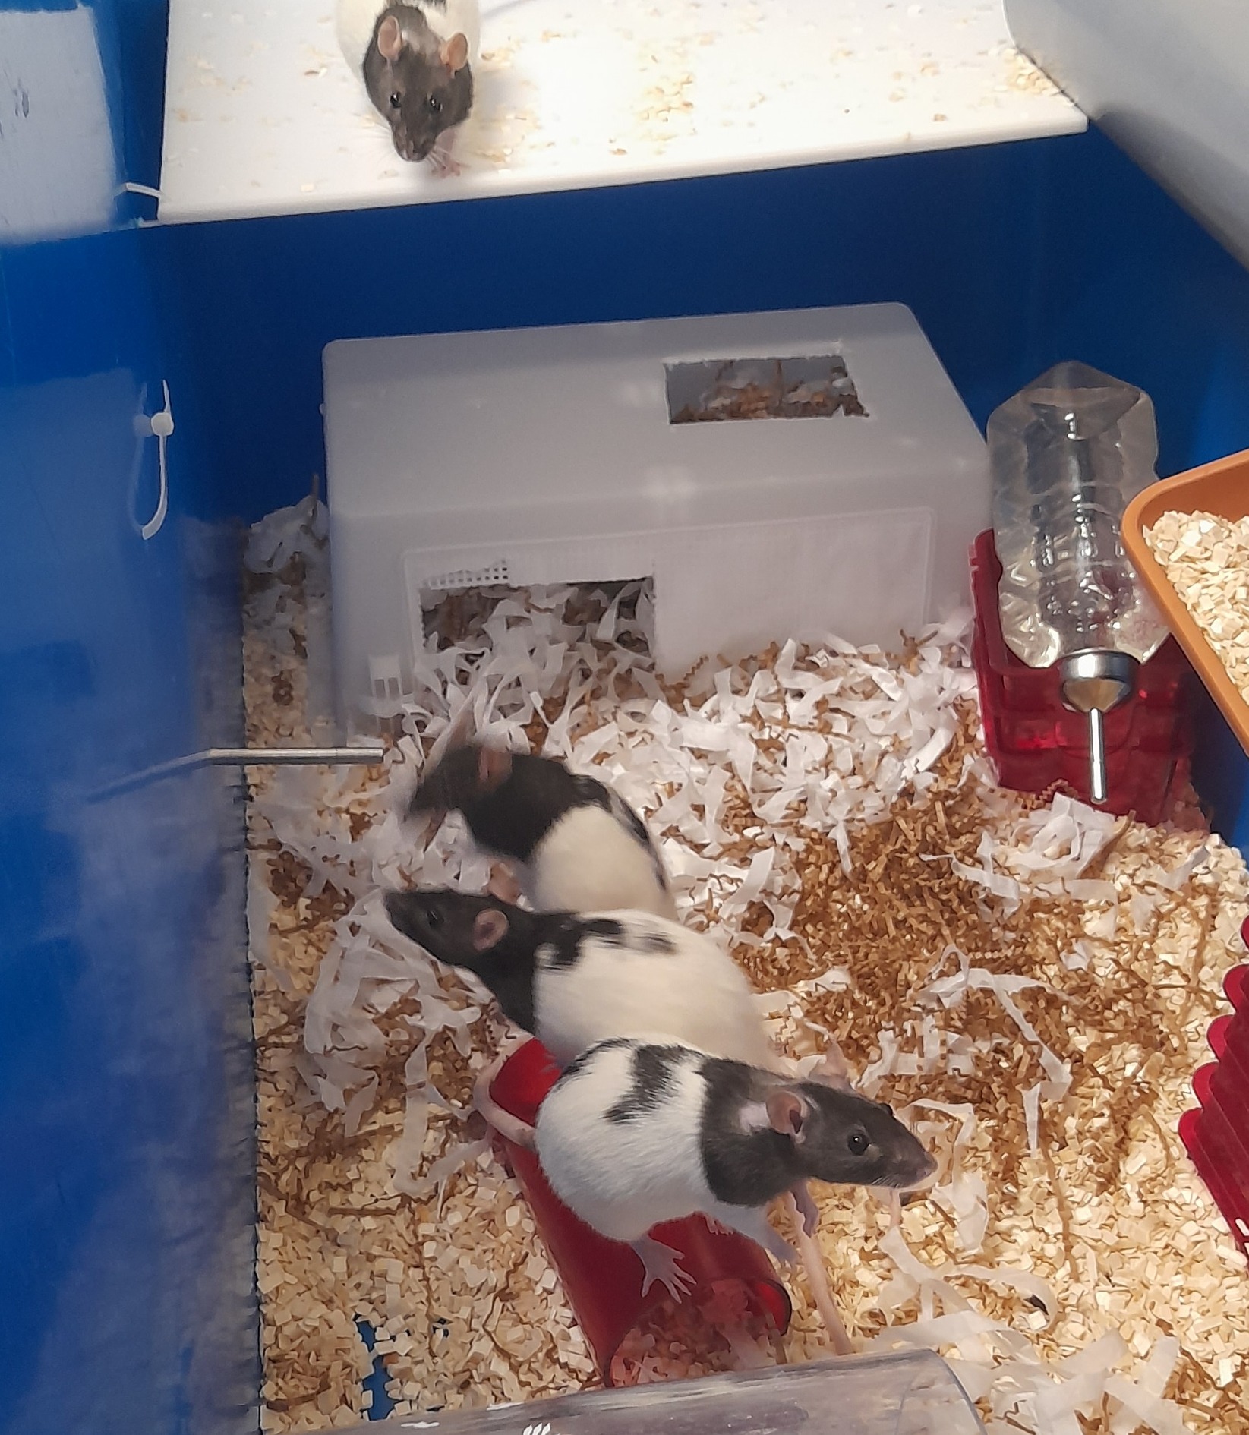
NVS as an AWERB committee member
Part of minimum membership: rota between four NVSs
Project Licences:
  Adverse Effects
  Controls and Humane Endpoints
  Surgery, Anaesthesia and Analgesia
  Possible Procedural Refinements
  Practical Implications
Retrospective Reviews:
  Issues and refinements
  Information dissemination
Areas to Raise:
  3Rs progress and strategy
  Facility issues e.g. health status

