Slide 1

NACWO role in AWERB
University Biomedical Services

Slide 2
NACWO ASPA responsibilities
“have up-to-date knowledge and experience of relevant animal technology and a thorough knowledge of the husbandry and welfare needs of the species kept in the establishment”
“be familiar with the main provisions of project licences, particularly the adverse effects expected for each protocol, the control measures and humane end-points specified and the methods of killing specified in licences”
“be an active member of the AWERB at your establishment, and advise applicants for licences and licence holders on practical opportunities for implementing the 3Rs.”

Slide 3
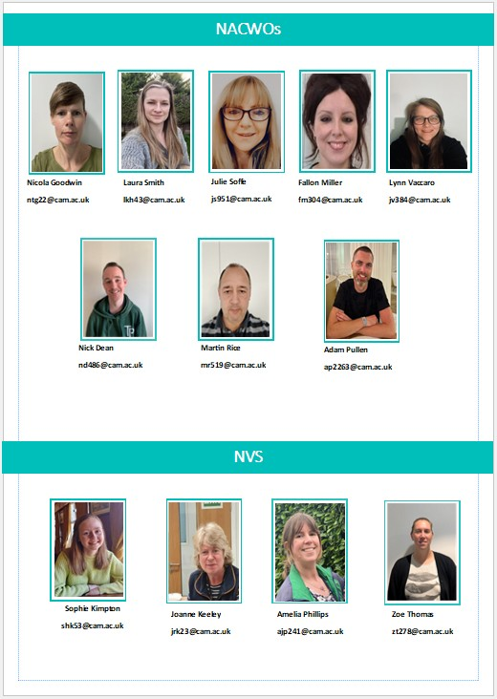
NACWO role at UBS
At UBS there are 8 facilities that house a range of species: for example Mice, rats, non human primates, horses, sheep.
There are 18 NACWOs at UBS to cover the varied species and facilities.
We ensure the facilities are staffed appropriately to ensure the animals can be cared for.
Assess animal health on a daily basis and maintain high standards of care.
Advise on PPL applications when they are being drafted.
Regularly refer to PPL’s once they are approved to identify expected adverse effects, monitoring requirements and humane endpoints to be able to sign off study plans.
All NACWOs can be reached on a group email address or there are some facility specific email addresses where there is more than one NACWO!

Slide 4
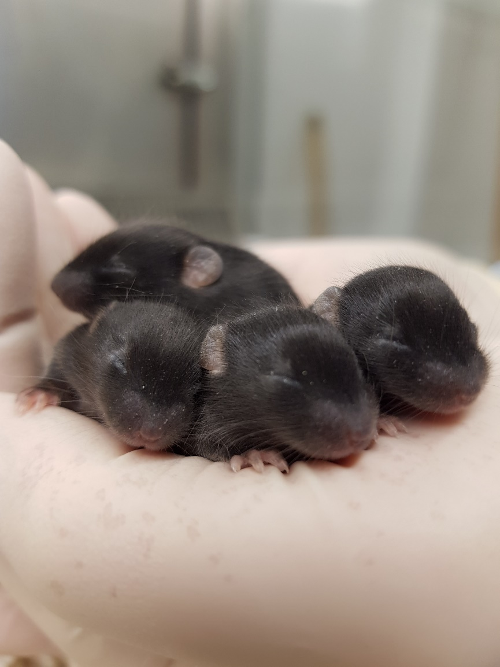
NACWO as an AWERB committee member
We sit on all AWERB committees, but as there are so many NACWOs this is on a rota basis, so there is at least one per meeting.
We mainly focus on the Project harms and protocols in the PPL and may ask questions on the adverse effects, monitoring, treatment and humane endpoints. We ensure that the facility can cater for the work proposed.

Slide 5
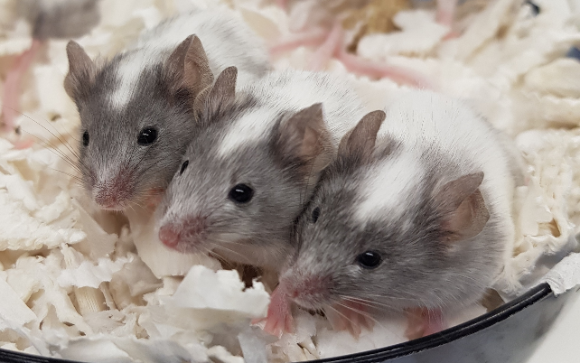
Other ways NACWOs support the AWERB
  Attend RCA’s to support further training and reassessments where needed.
  Provide advice prior to submission of SC18’s when needed.
  New users are inducted to facilities and supported through their personal licence training, procedural training and all other aspects of working with animals.
  Implement refinements where possible through study plan review, previous experience or published posters.
Reporting of potential non compliance (RCA/SC18’s)
Training of new users
Implementing the 3Rs

