Slide 1

Single Housing:
Auto-watering and Dehydration Risk
Colony Management Group April 2023
Dr Amelia Phillips MRCVS
Named Veterinary Surgeon
University Biomedical Services

Slide 2
AIM: Raise awareness from recent incidences
Occasionally animals who become singly housed, when on the auto-watering system, have difficulty drinking from the system, even if they were using it fine before.
Recognising and confirming Dehydration
Treating Dehydration
Dehydration Protocol
Preventing Dehydrating when setting up a singly housed cage
Regarding Irradiation

Slide 3
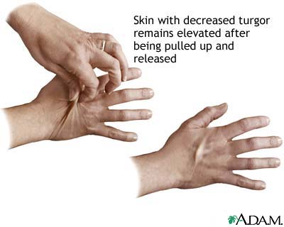
Recognising and confirming Dehydration
Active mouse – jumpy and twitchy – or under-active – non-responsive
Pinched abdomen & hunched posture
Piloerection
Weight loss – often substantial - 10-15% in 12-24 hours
Dish test – offer water in a low dish and
drinking is immediate
Skin tent test
Use your technician and NACWO

Slide 4
Treating Dehydration
Weigh the animal to ascertain weight drop, and record on MCMS along with a Health Concern
  Use as a benchmark to monitor recovery
  Health Concerns allow monitoring and retrospective assessment
  If below licence authority need to consider sch1 or KAR
Provide easily accessible water:
  Water dish/ Mash/ hydrogel/ water pouch/ Complan
Check the auto-watering nozzle – prime it with your finger to get a drop out

Slide 5
Treating Dehydration
3 day monitoring regime:
  Weighing twice a day – restored (usually by 24 hours) and maintained
  Label the cage
  Prime the nozzle twice a day
  Group house, if possible

Slide 6
Dehydration Protocol
Get Senior/NACWO advice to confirm
Yes
Suspected dehydration
Weigh mice and record weight on MCMS
Provide a petri-dish of water from cage’s valve
No
Could be a different underlying health condition – Seek NACWO/NVS advice
Record health observation on MCMS. Be as descriptive as possible.
Did mice flock to and drink desperately from it?
Provide hydrogel and mash/diet gel
Weigh/assess on PM
No
Seek NACWO advice
Continue daily health observations for 2-3 days to ensure recovery. Place a label on cage ‘previously dehydrated ‘ for a week. Prime valves twice a day to encourage drinking until recovered.
NEXT DAY -Weigh and assess mouse for clinical signs
Has the mouse gained weight and isn’t showing clinical signs?
Yes

Slide 7
Preventing Dehydrating when setting up a singly housed cage
Colony Management and Experimental design to avoid single housing as much as possible
Prime the nozzle twice a day for the first 7 days
Provide hydrogel or mash for the first 7 days
Same as if for newly weaned mice
Any other ideas?

Slide 8
Regarding Irradiation
And other procedures involving moving mice on and off auto-watering systems
Check the water pouch and nozzle are:
  Fitted to the cage correctly
  Not hindered by cage furniture
  Prime the nozzle twice a day
Provide other sources of easily accessible water
Introduce waterbags in advance of moving off auto-watering

